Slide 1
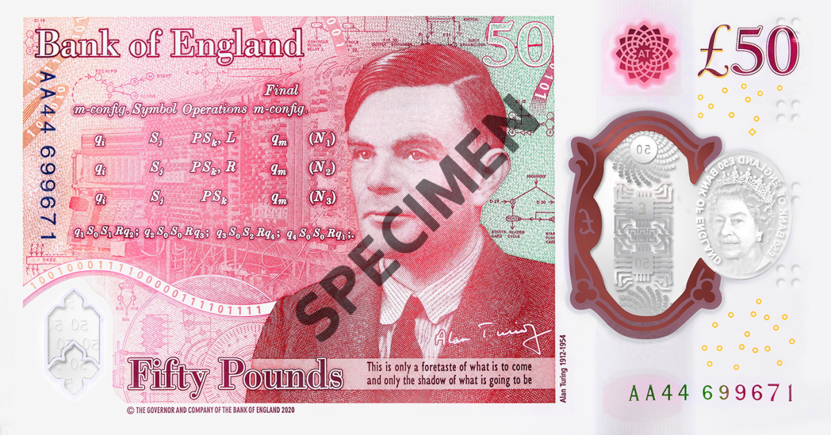
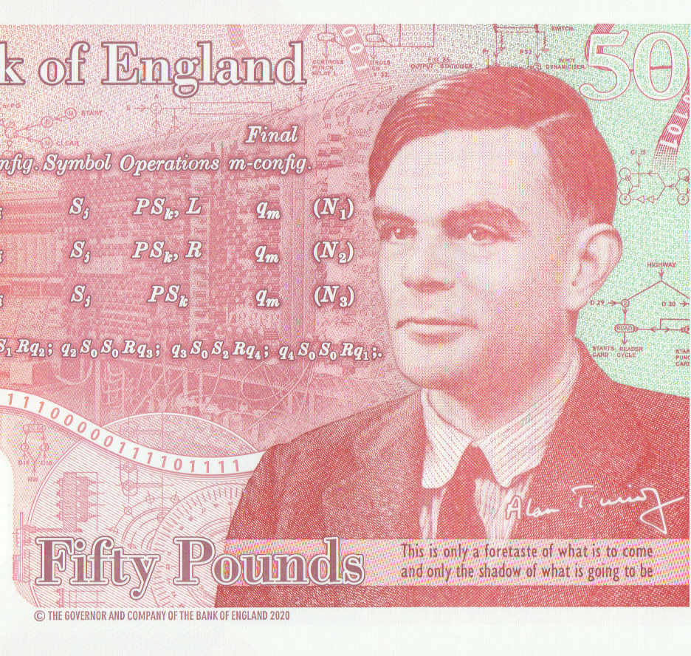
CS 170 Intro to Artificial Intelligence
Dr Eamonn Keogh eamonn@cs.ucr.edu www.cs.ucr.edu/~eamonn/ MRB: 4120

Slide 2
COVID-19 Statement
Welcome back!
It has been an interesting 18 months…
I am happy you made it here today.
Please comply with all UCR covid regulations.
I also understand that many of you are having difficulties with this situation, lower bandwidth, less access to peers, financial worries etc. I will try to be understanding, please let me know what you need to succeed.

Slide 3
Before we begin to learn, the usual administration trivia…
Most of the slides and materials for the class are online (or will be soon).
The canvas splash page for this class has a link to the DropBox, where I host the files (I am slowly porting to Canvas).
I often edit and update files, make sure you have the latest version.
Also online are videos of me teaching this class on zoom this winter.
I would much prefer you attend these lectures than watch these videos.
However, these videos may be a useful resource for a quarantined student.

Slide 4
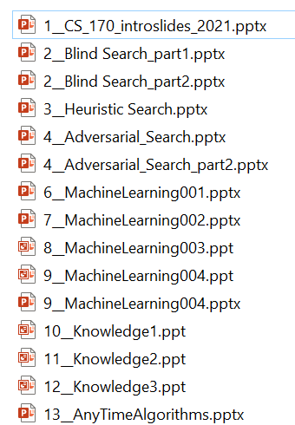
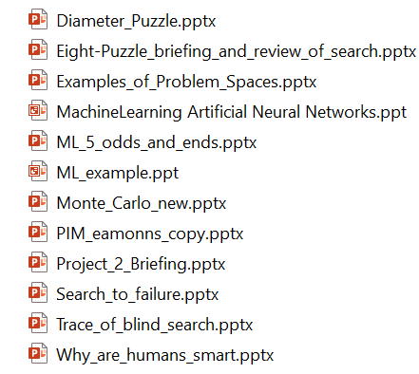
This is the approximate order of the slides
However, I will be augmenting these with many shorter slide decks, in order to be determined.

Slide 5
Grading
Midterm Exam: ~ 10%
Final Exam (cumulative) ~ 10%
HW Assignments/quizzes/participation: ~ 10%
Two projects (solo) ~ 70%
There will be a few extra credit possibilities
Programming assignments can be in any language

Slide 6
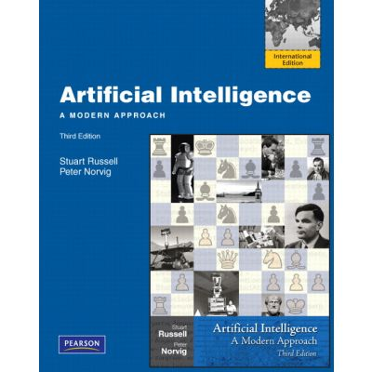
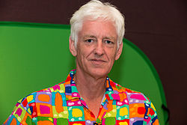
TextBook
Optional
Artificial Intelligence: A Modern Approach
Stuart Russell and Peter Norvig
University of California, Berkeley
Director of Research at Google Inc.

Slide 7
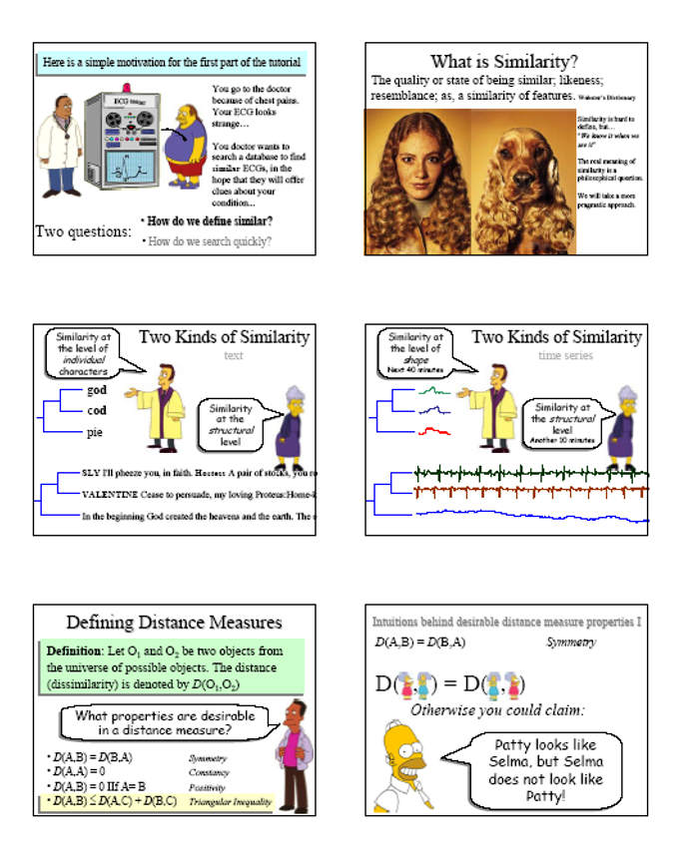
Slides
I make very nice slides.
I deliberately put only about 90% of the material I want to communicate on the slides.
The remaining 10% I explain at lecture, and I expect you to annotate your slides to reflect this.

Slide 8
Cheating Policy
Students must read and understand UCR policy on academic honesty. http://www.cs.ucr.edu/curriculum/acad_honest.html
Note, I am very good at detecting cheating (I have taught classes on the subject). Anyone caught cheating will given a final grade of F and will have a letter placed in his or her permanent record. Students are expected to take care that others cannot “cheat off them”. For example, if leave your homework on a shared hard drive or an abandoned USB and someone else hands it in, you are liable and will have your grade adjusted downward.

Slide 9
Do not share my materials
“My lectures and course materials, including powerpoint presentations, tests, outlines, and similar materials, are protected by U.S. copyright law and by University policy. I am the exclusive owner of the copyright in those materials I create. You may take notes and make copies of course materials for your own use. You may also share those materials with another student who is registered and enrolled in this course.
You may not reproduce, distribute or display (post/upload) lecture notes or recordings or course materials in any other way — whether or not a fee is charged — without my express written consent. You also may not allow others to do so. If you do so, you may be subject to student conduct proceedings under the UC Riverside Student Code of Conduct, Section 102.23.
Similarly, you own the copyright in your original papers and exam essays. If I am interested in posting your answers or papers on the course web site, I will ask for your written permission.”
“This content is protected and may not be shared, uploaded or distributed.”

Slide 10
Office Hours
Let's vote on where and when to have office hours, in the second class meeting

Slide 11
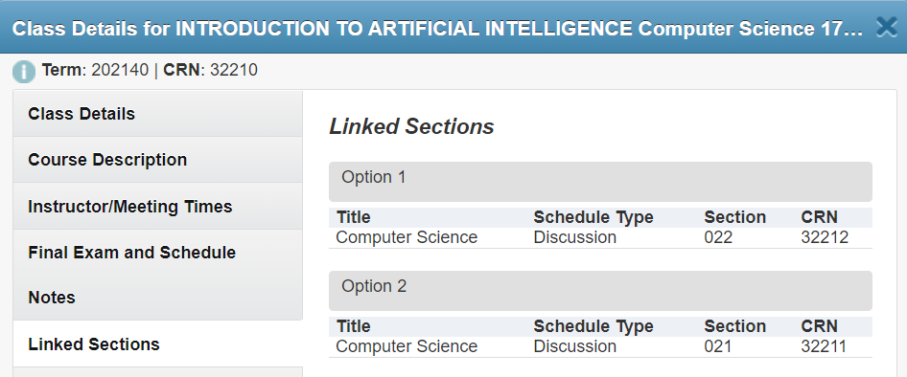
Discussion Sections do not meet!
These sections do not meet (they are a sort fossil from an older offering)
However, you are paying for this time ;-)
As such, I use these hours to hold additional optional office hours.
If you want to meet during this time, just send me an email (24 hours in advance).
These meetings would be zoom only.

Slide 12
Email Policy
Please put cs170 in the subject line of every email you send me.
Please avoid cryptic emails.
Please avoid: WDYMBT Am I 2L8 4 UR exam?

Slide 13
Questions?
Review:
Cheating, that’s a paddlin’

Slide 14
What is AI?
“A Steven Spielberg movie that really sucked”
Eamonn Keogh
“The capacity of a digital computer to perform tasks commonly associated with the higher intellectual processes characteristic of humans, such as the ability to reason, discover meaning, generalize, or learn from past experience.”
Encyclopaedia Britannica.
AI is trying to solve by computer any problem that a human can solve faster/better.
“FOLDOC”

Slide 15
Why Study AI? Part I
Computers with intelligence would have (are having) a huge impact on civilization.
Unlike faster-than-light-travel or time travel devices, there is strong evidence that AI is actually possible (hint, it is between your ears).
AI (along with genetics) is most often cited as “the field I would most like to be in” by researchers in other fields.
Personal motivation. The last big mystery?

Slide 16
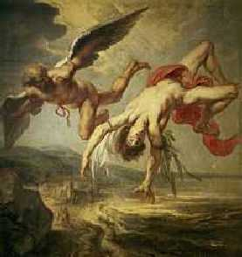
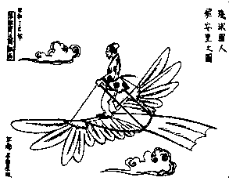
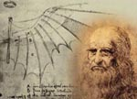
Why Study AI? Part II
Some people who study AI are only interested in solving problems. Others reason like this… “I want to study humans, since the most interesting feature of humans is their intelligence, I will study artificial intelligence to understand true intelligence”.
This has always struck me as a weak argument. The very earliest attempts at flight tried to emulate birds by building flying machines that flapped their wings (ornithopters). Although manned aircraft can hover/carry enormous loads/fly faster than sound, no manned ornithopter has ever flown.

Slide 17
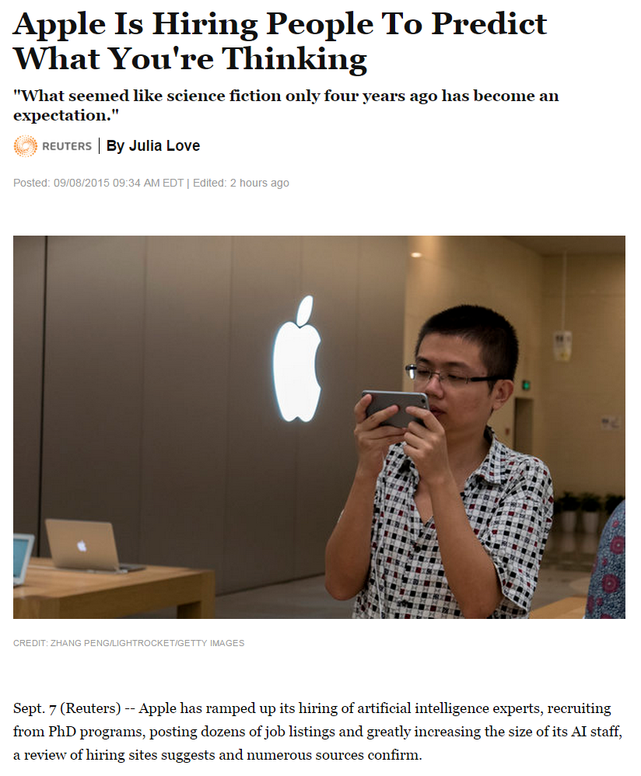
Why Study AI? Part III
There is a huge need for AI researchers and practitioners.
This has created a bidding war for talent.
Experts in AI (or machine learning, data science, data mining etc.) have lots of high-paying job opportunities.
(Reuters) -- Apple has ramped up its hiring of artificial intelligence experts, recruiting from PhD programs, posting dozens of job listings and greatly increasing the size of its AI staff, a review of hiring sites suggests and numerous sources confirm….

Slide 18
Where are we in AI?
AI is trying to solve by computer any problem that a human can solve faster/better.
So, we can see the performance of AI on a given problem as:
optimal: it is not possible to perform better
strong super-human: performs better than all humans
super-human: performs better than most humans
par-human: performs similarly to most humans
sub-human: performs worse than most humans

Slide 19
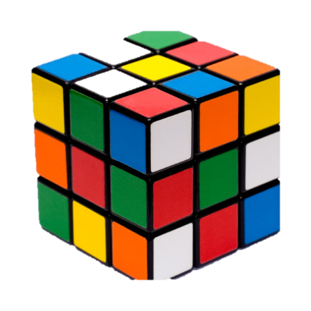
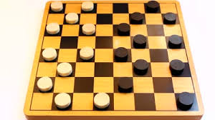
optimal: it is not possible to perform better
Arithmetic (now not normally considered an AI problem)
Checkers (draughts)
Rubik's Cube (as we will see, AI takes 20 moves or fewer)
15-Puzzle (But not optimal for larger versions)
Playing Poker (most variations)
Shortest Route Finding (i.e., directions on Google maps)

Slide 20
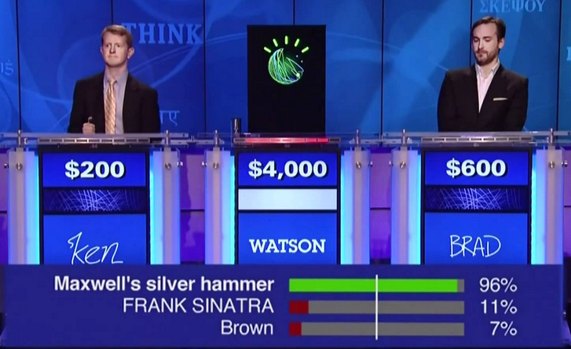
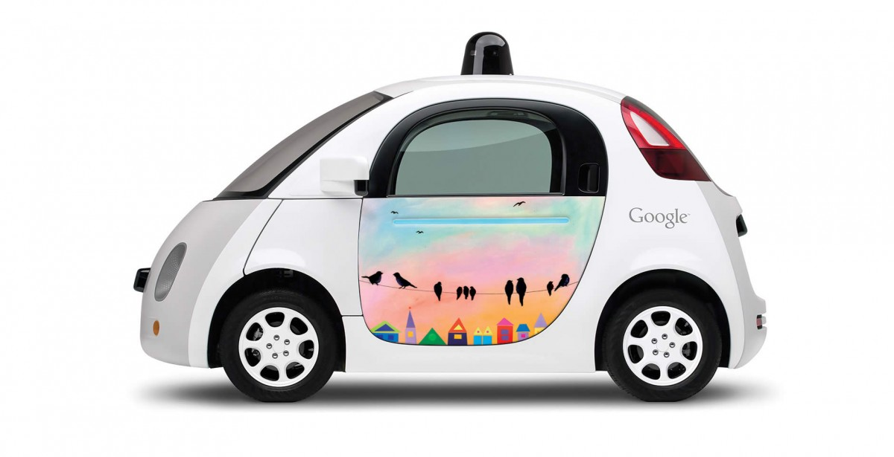
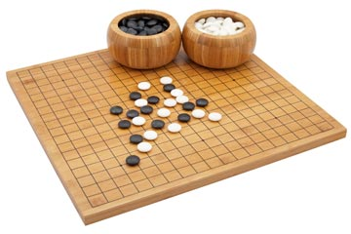
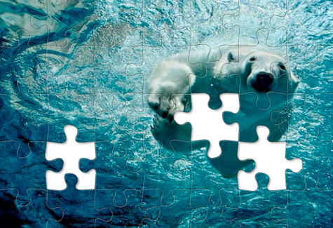
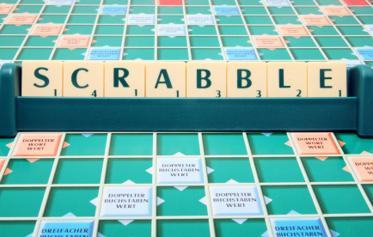
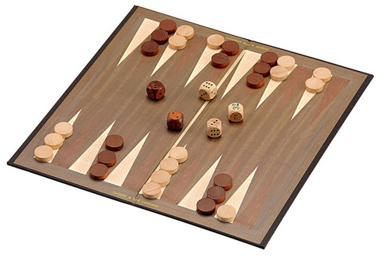
super-human: performs better than most humans
Backgammon: Since about 1992
Chess: Since about 1997
Go: Since about 2017
Crosswords:
Jigsaw puzzles:
Scrabble:
Quiz show question answering:
Driving a car: super-human. With qualifications
(Google driverless cars are safer and smoother when steering themselves than when a human takes the wheel. However, most tests have been in good weather, good traffic. Perhaps humans have the edge for now in driving in snow storms, or driving in India https://www.youtube.com/watch?v=RjrEQaG5jPM#t=43)

Slide 21
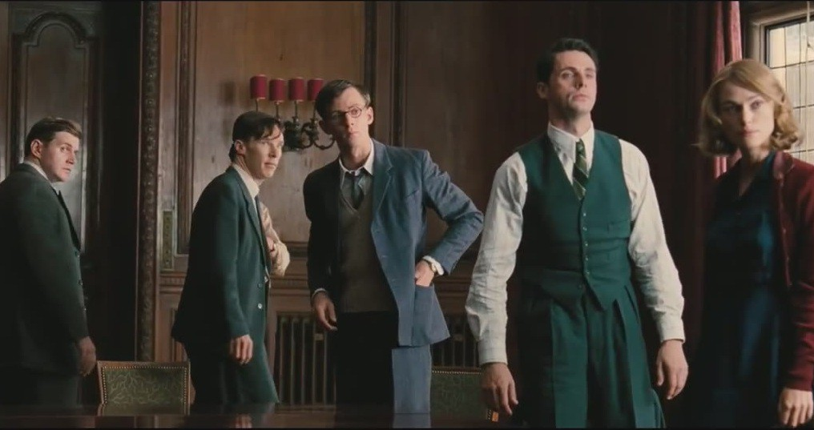
super-human: performs better than most humans
Cryptanalysis
The Imitation Game (2014)
Joan Clarke
(1917 to 1996)

Slide 22
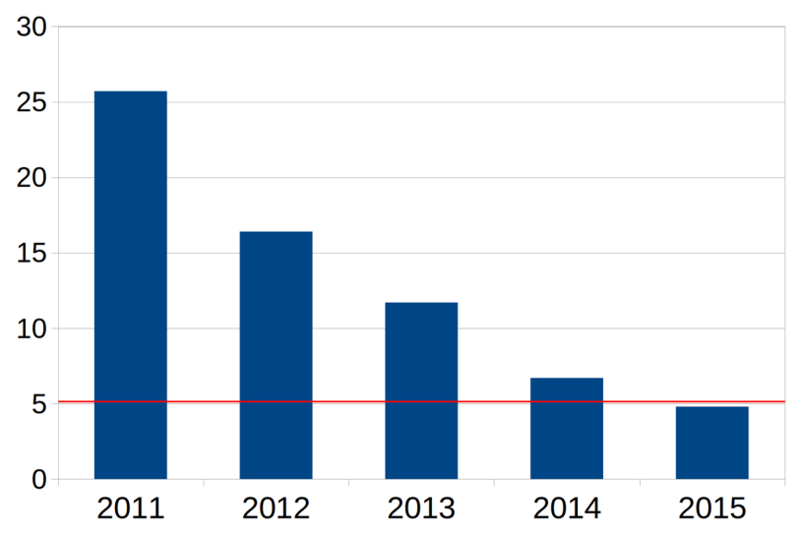
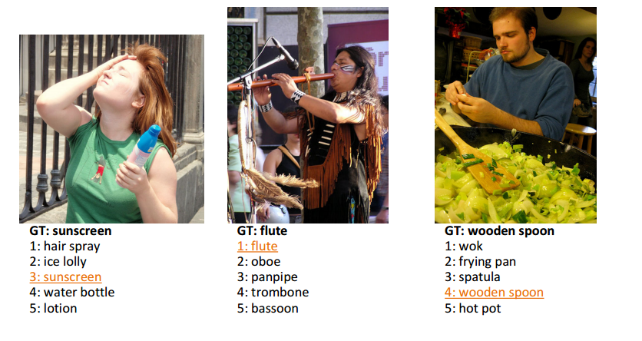
par-human: performs similarly to most humans
Optical character recognition for certain fonts (ISO 1073-1, MICR)
Bridge (card game)
Many image classification problems
Is there a face in this image?
What is the sex/age of the person?
Is this person happy/sad/surprised/angry/disgusted?
Is this person Michael Smith? (may be superhuman)
Is this person attractive?
Trained human
arxiv.org/pdf/1502.01852v1.pdf
Progress on Imagenet large scale visual recognition challenge.

Slide 23
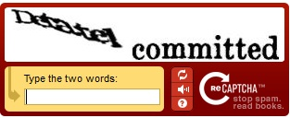
sub-human: performs worse than most humans
Handwriting recognition (but closing fast)
Language Translation (i.e. English to Chinese)
Speech recognition (but closing very fast)
Word-sense disambiguation
Natural language processing
Captcha (by definition!)
The boy leapt from the bank into the water.
The bank was closed.
Susan saw a diamond ring in the window of a department store in New York, and she press her nose against it.
Does the ‘it’ refer to the ring, the window, the department store, or New York?
AI had sub-human ability on this kind of Captcha just a few years ago, now AI is par-human

Slide 24
sub-human: performs worse than most humans
Handwriting recognition (but closing fast)
Language Translation (i.e. English to Chinese)
Speech recognition (but closing very fast)
Word-sense disambiguation
Natural language processing
Captcha (by definition!)
The boy leapt from the bank into the water.
The bank was closed.
Susan saw a diamond ring in the window of a department store in New York, and she press her nose against it.
Does the ‘it’ refer to the ring, the window, the department store, or New York?
AI had sub-human ability on this kind of Captcha just a few years ago, now AI is par-human

Slide 25
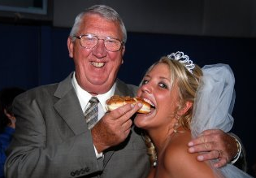
sub-human: performs worse than most humans
Common Sense Reasoning
Suppose I point to this photo and ask: “which person in this photo was not a millionaire yesterday?”

Slide 26
sub-human: performs worse than most humans
Common Sense Reasoning
Suppose I point to this photo and say “can you tell me which person in this photo was not a millionaire yesterday?”
An AI would have to:
Transcribe my spoken words into ASCII Pretty Easy
Understand what is been asked. Difficult
Find the “persons” in the photo. Pretty Easy
The AI could extract some more information from the image. It could get both sex and age. Pretty Easy It could get emotion/attractiveness (not shown) Pretty Easy
The AI might get the concept “wedding”. Difficult
However, much of the task requires information is not explicit in the image.
The average marriage age difference is just 3 or 4 years (in most of the western world).
Most people tend to marry someone with about the same “attractiveness” level.
In the western world, most married couples share financial resources (and alimony would ensure this in the case of divorce).
Of a couple, the man is much more likely to be a millionaire (sad, but true).
Some people may be willing to trade attractiveness of partner for financial security.

Slide 27
The Ultimate Goal of AI
We don’t want to have lots of different programs to solve lots of different problems, Narrow AI
(Imagine if we different sorting algorithms for sorting names, sorting ages, sorting heights, sorting GPAs, sorting dollars, sorting Euros etc.)
We would like a single program that can do everything, Artificial General Intelligence (AGI)
AGI is sometimes called Strong AI or Full AI or High-level machine intelligence (HLMI)
How would we know if we ever achieve AGI? That is a surprisingly deep question…
The answer, like many things in CS, comes from…

Slide 28
The Imitation Game (2014)
Alan Turing
1912 – 1954

Slide 29
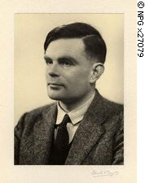
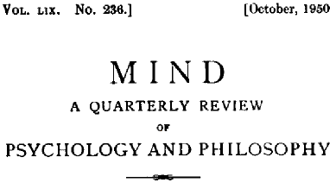
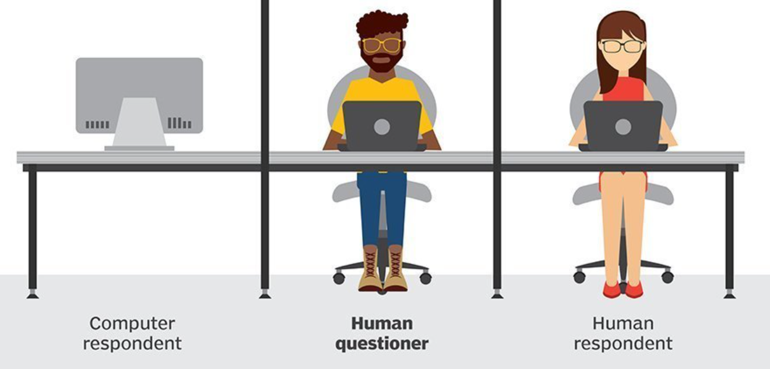
How do we know if we have succeeded?
Alan Turing
1912-54
The Turing Test
The human must try to determine if he is talking to a human or a machine.
The computer can lie!
The test does not check the ability to give correct answers to questions, only how closely answers resemble those a human would give.
The conversation would be limited to a text-only channel such as a computer keyboard and screens so that the result would not be dependent on the machine's ability to render words as speech.

Slide 30
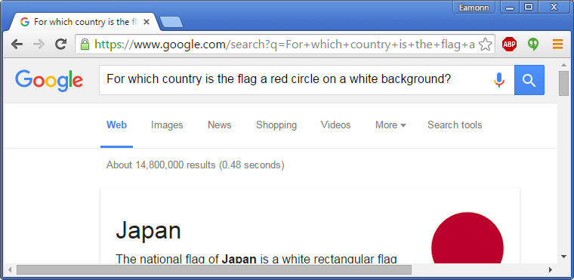
What questions would you ask in a Turing Test?
What is the cube root of 13? (computer is allowed to pause, and give an approximate answer)
My King is on the K1 square, and I have no other pieces. You have only your King on the K6 square and a Rook on the R1 square. Your move. (This is in Turing’s paper. In 1950 he realized that chess-playing computers would be inevitable, Rook to R8, checkmate)
For which country is the flag a red circle on a white background?
John is fat and tall and in a very bad mood, his dad David, is illiterate, loves Chinese food and wears ugly clothes, who is older, John or David? (I added red herrings)
What would an “M” look like if you were standing on your head?
What do you think of Roald Dahl? (and probe with follow up questions)
Bob weighs 12 pounds, Bob likes to chase mice, Bob is afraid of dogs, What is Bob?
Please explain these jokes:
I went to the bank the other day and asked the banker to check my balance, so she pushed me!
The early bird might get the worm, but the second mouse gets the cheese.
Politicians and diapers have one thing in common. They should both be changed regularly, and for the same reason.

Slide 31
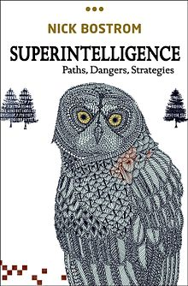
A Stunning Idea
If one day we have Artificial General Intelligence, then the next day we will have Superintelligence!
This is sometimes called “the singularity”
See recent works by
Ray Kurzweil
Nick Bostrom

Slide 32
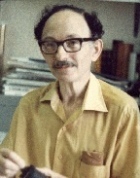
Irving John (I. J.) Good
(1916 –2009)

Slide 33
intelligence
Today
human
chimp
monkey
mouse
Let us imagine for a moment that you could measure intelligence on a linear scale, something like:
...< bacteria < mouse < monkey < chimp < average human < stephen hawking < …
And let us imagine that we are building smarter and smarter AIs, constantly moving up this hierarchy over time…

Slide 34
…the last invention that man need ever make.
Recursive Self-Improvement
Suppose humans can make AI₁ that can do anything humans can.
That means that AI₁ can make an AI!
Now assume that AI₁ can make a new version of itself, AI₂ that is 10% smarter, in one hour.
And AI₂ can make a new version of itself, AI₃ that is 10% smarter, in one hour.
And AI₃ can make a new version of itself, AI₄ that is 10% smarter, in one hour.
etc.
Then at the end of day one, the AI₂₄ will be 9.8 times smarter than a human
Then at the end of week one, the AI₁₆₈ will be 8.9 million times smarter than a human
intelligence
human
Let an ultraintelligent machine be defined as a machine that can far surpass all the intellectual activities of any man however clever. Since the design of machines is one of these intellectual activities, an ultraintelligent machine could design even better machines; there would then unquestionably be an 'intelligence explosion,' and the intelligence of man would be left far behind. Thus the first ultraintelligent machine is the last invention that man need ever make.

Slide 35
What will it be like to be a human in the presence of an intelligence so much greater than our own?
intelligence
human
The Library of Congress is the worlds largest library, with 40 million books. However, the ASCII text of all those books can fit into main memory. If the AI can read at CPU throughput speeds, it could read the entire Library of Congress in the first few minutes of its “life”.
We can only understand video/audio at normal speed, but the AI could watch videos at 10,000X or 1,000,000X speed. So, ask it a question about the Simpsons…
In the Simpsons TV show, how many siblings does Homer have?
..and it can watch every show before you finish your question.

Slide 36
When, if ever, will we have AGI?
Katja Grace asked all researchers who published at the 2015 NIPS and ICML conferences (top AI venues).
There was huge variation in the responses, including some folk who claim never
However, the aggregate forecast gave:
a 50% chance of HLMI occurring within 45 years
a 10% chance of it occurring within 9 years
https://arxiv.org/pdf/1705.08807.pdf

Slide 37
The Best Case
We obtain strong AI…
.. now 99.9% of all humans are now unemployed, but that is OK.
We can control the AI, and we use it to cure cancer, create renewable energy, to explore the universe…

Slide 38
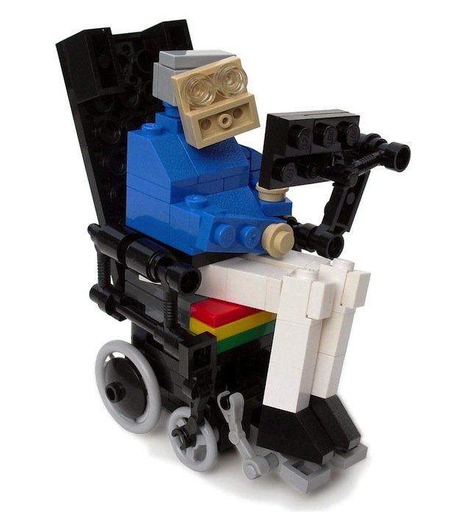
The Worst Case
Success in creating AI would be the biggest event in human history. Unfortunately, it might also be the last, unless we learn how to avoid the risks
We obtain strong AI
The AI kills us all
Or
Humans weaponize the AI
Stephen Hawking, Bill Gates and Elon Musk have expressed concerns about the possibility that AI could evolve to the point that humans could not control it.

Slide 39
Obligatory Dilbert Cartoon

Slide 40
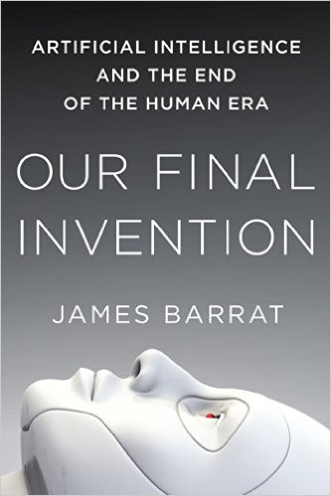
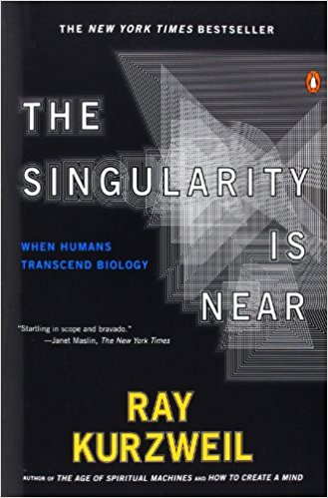
Checkpoint
This is not a class on the philosophy of AI
The is a pragmatic class on doing AI
If you are interested, I recommend the following books

Slide 41
The plan for the quarter (subject to change)
Three weeks studying search (exhaustive search, uninformed search, informed search, adversarial search).
Three weeks studying machine learning (nearest neighbor and decision trees classification, neural networks and clustering).
Two weeks studying logic systems (propositional logic, first order logic, resolution).
A week of advanced topics (possible topics: genetic algorithms, bayesian networks, similarity, biometrics...).

Slide 42
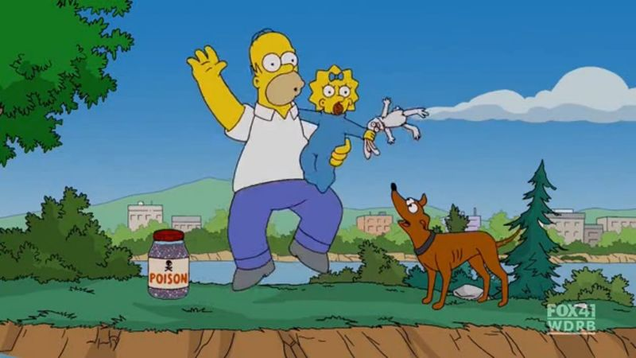
The Farmer, Wolf, Duck, Corn Problem
Farmer, Wolf, Goat, Cabbage
Farmer, Fox, Chicken, Corn
Farmer Dog, Rabbit, Lettuce
Homer, Maggie, poison, Santa’s Little Helper
A farmer with his wolf, duck and bag of corn come to the east side of a river they wish to cross. There is a boat at the rivers edge, but of course only the farmer can row. The boat can only hold two things (including the rower) at any one time. If the wolf is ever left alone with the duck, the wolf will eat it. Similarly, if the duck is ever left alone with the corn, the duck will eat it. How can the farmer get across the river so that all four arrive safely on the other side?
The Farmer, Wolf, Duck, Corm problem dates back to the eighth century and the writings of Alcuin, a poet, educator, cleric, and friend of Charlemagne.

Slide 43
This means that everybody/everything is on the same side of the river.
F W D C
This means that we somehow got the Wolf to the other side.
F D C
W

Slide 44
F
W
D
C
W
D
C
D
C
W
C
W
D
F
F
W
F
D
F
C
Search Tree for “Farmer, Wolf, Duck, Corn”
Illegal State

Slide 45
F
W
D
C
W
D
C
D
C
W
C
W
D
F
F
W
F
D
F
C
F
W
C
F
W
D
C
D
Search Tree for “Farmer, Wolf, Duck, Corn”
Illegal State
Repeated State

Slide 46
F
W
D
C
W
D
C
D
C
W
C
W
D
F
F
W
F
D
F
C
F
W
C
F
W
D
C
D
W
C
C
W
F
D
F
W
D
F
D
C
F
C
F
W
C
F
D
C
F
W
F
W
D
F
W
C
W
D
D
W
D
C
C
D
D
C
C
D
W
D
D
W
F
W
F
W
D
F
W
C
F
C
F
W
C
F
D
C
F
D
F
W
D
F
D
C
W
C
C
W
D
F
W
C
F
W
D
C
Search Tree for “Farmer, Wolf, Duck, Corn”
Illegal State
Repeated State
Goal State

Slide 47
F
W
D
C
F
W
D
C
Initial State
W
C
W
C
Farmer takes duck to left bank
F
D
F
D
F
W
C
F
W
C
Farmer returns alone
D
D
C
C
Farmer takes wolf to left bank
F
W
D
F
W
D
F
D
C
F
D
C
Farmer returns with duck
W
W
D
D
Farmer takes corn to left bank
F
W
C
F
W
C
F
D
F
D
Farmer returns alone
W
C
W
C
Farmer takes duck to left bank
F
W
D
C
F
W
D
C
Success!

Slide 48
It is no surprise to learn that the technique used to solve Farmer, Wolf, Duck, Corn can be used to solve other similar problems...
Missionaries and Cannibals: (three of each, boat holds 2, if cannibals outnumber the missionaries they'll eat them).
Jealous Husbands: three couples, boat holds 2 people at most, no wife can be left with any man unless her husband is also present.
U2 has a concert that starts in 17 minutes and they must all cross a bridge to get there. All four men begin on the same side of the bridge. You must help them across to the other side. It is night. There is one flashlight. A maximum of two people can cross at one time. Any party who crosses, either 1 or 2 people, must have the flashlight with them. The flashlight must be walked back and forth, it cannot be thrown, etc. Each band member walks at a different speed. A pair must walk together at the rate of the slower man's pace. Bono takes 1 minute to cross, the Edge takes 2 minutes to cross, Adam takes 5 minutes to cross, and Larry takes 10 minutes to cross. How can they accomplish the crossing in the allotted time?
What is surprising, is that search can be used to solve an amazing number of important problems that don’t appear (at first glance) to be amiable to search...

Slide 49
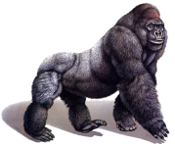
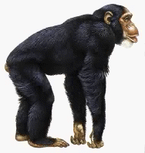
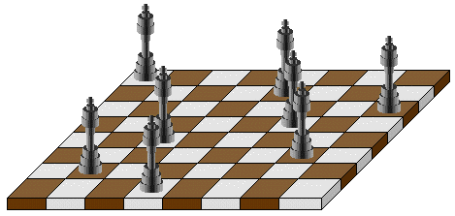
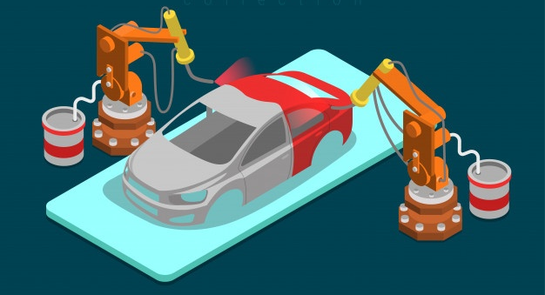
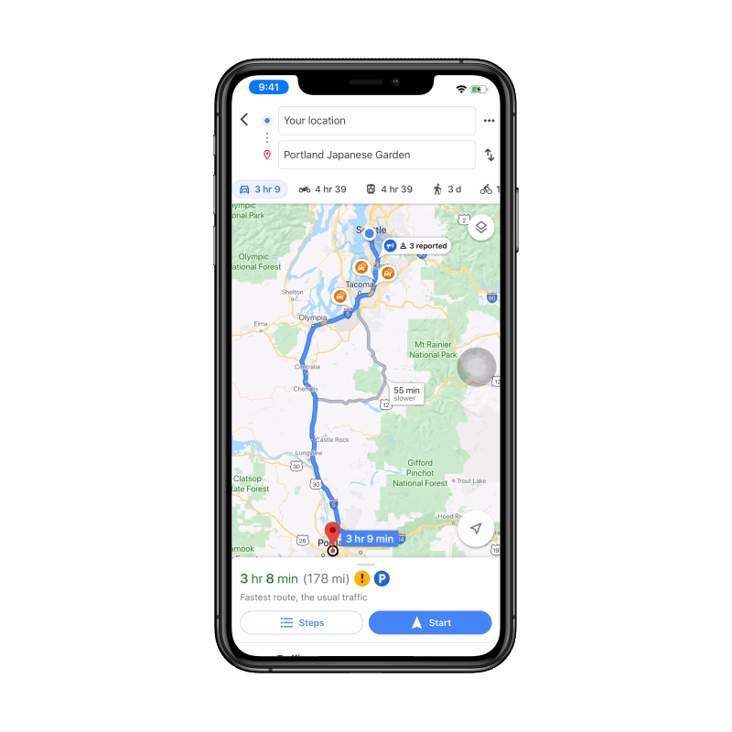
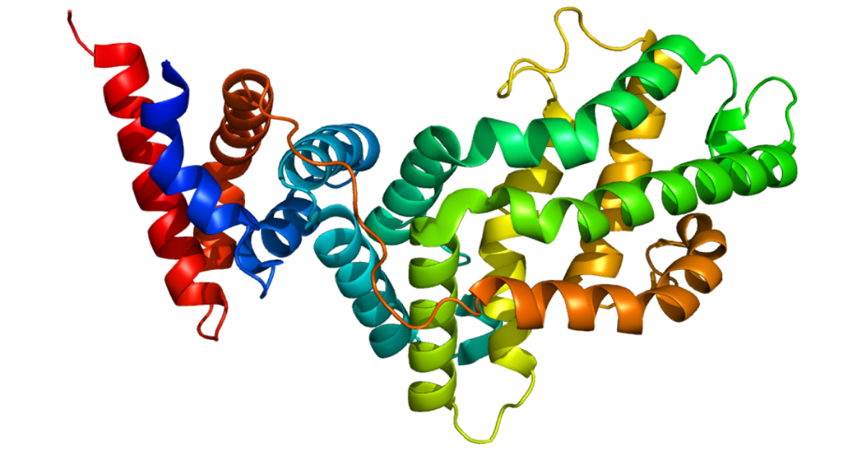
Reassemble these torn fragments into the original image
Which tree shows the correct relationship between gorilla, chimp and man?
When you have just 3 animals, there are only three possible trees, but with ten species there are 34,459,425 possible trees
Rubiks Cube
Can you place 8 queens on a chessboard such that no piece is attacking another?
What is the fastest way to paint this car?
How would this protein string.. HETATRQTETRQKIKFPCIMMWFGDCYEDY
..fold in 3D?
Find a route from my home to the airport that minimizes the mileage
What is the fastest way to unload this container ship of all red containers?

Slide 50
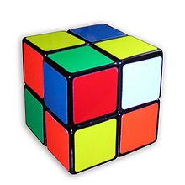
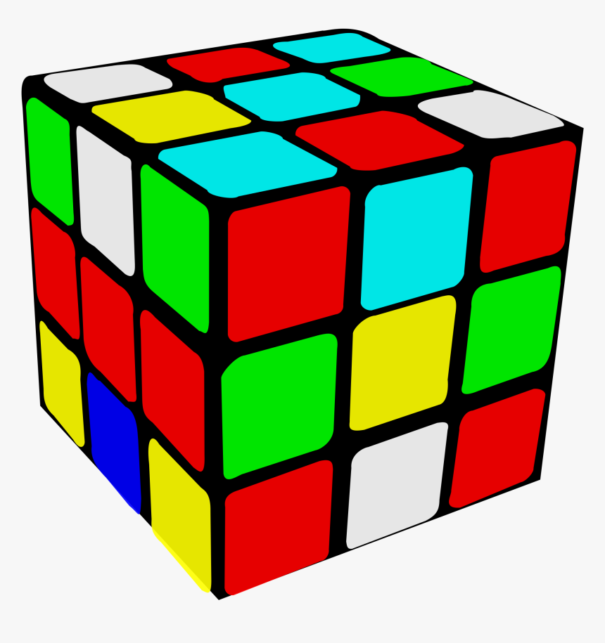
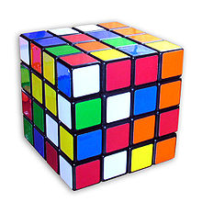
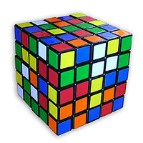
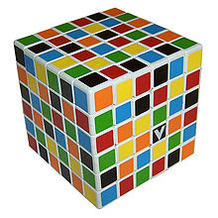
We have seen that the Farmer, Wolf, Duck, Corn can be easily solved using search. So why spend so much time on a trivial technique for solving problems?
Farmer, Wolf, Duck, Corn has a tiny search space! About size 5000
However, many real-world problems have very large (possibly infinite) search spaces. How do we search in such massive spaces?
n*n cube Size of search space
3674160
43252003274489856000
7401196841564901869874093974498574336000000000
282870942277741856536180333107150328293127731985672134721536000000000000000
157152858401024063281013959519483771508510790313968742344694684829502629887168573442107637760000000000000000000000000
Much larger than #electrons in the universe times #milliseconds since big bang

Slide 51
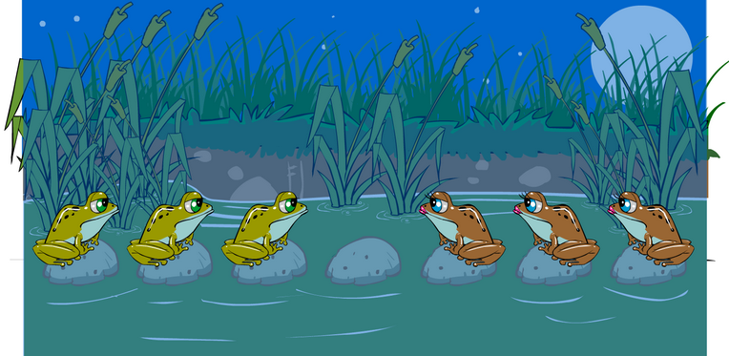
For next time
Slides on Blind Search
Spend 10 minutes playing Frogs and Toads
https://nrich.maths.org/content/00/12/game1/frogs/index.html#/student/2/2

Slide 52
That was search… Now lets preview Machine Learning….

Slide 53
Pigeon Problem 1
Examples of class A
Examples of class B
3 4
5 2.5
1.5 5
5 2
6 8
8 3
2.5 5
4.5 3

Slide 54
Pigeon Problem 1
What class is this object?
Examples of class A
Examples of class B
3 4
5 2.5
8 1.5
What about this one, A or B?
1.5 5
5 2
6 8
8 3
4.5 7
2.5 5
4.5 3

Slide 55
Pigeon Problem 1
This is a B!
Examples of class A
Examples of class B
3 4
5 2.5
8 1.5
1.5 5
5 2
Here is the rule.
If the left bar is smaller than the right bar, it is an A, otherwise it is a B.
6 8
8 3
2.5 5
4.5 3

Slide 56
Pigeon Problem 2
Oh! This ones hard!
Examples of class A
Examples of class B
4 4
5 2.5
8 1.5
Even I know this one
5 5
2 5
6 6
5 3
7 7
3 3
2.5 3

Slide 57
Pigeon Problem 2
Examples of class A
Examples of class B
The rule is as follows, if the two bars are equal sizes, it is an A. Otherwise it is a B.
4 4
5 2.5
5 5
2 5
So this one is an A.
6 6
5 3
7 7
3 3
2.5 3

Slide 58
Pigeon Problem 3
Examples of class A
Examples of class B
6 6
4 4
5 6
This one is really hard!
What is this, A or B?
1 5
7 5
6 3
4 8
3 7
7 7

Slide 59
Pigeon Problem 3
It is a B!
Examples of class A
Examples of class B
6 6
4 4
5 6
The rule is as follows, if the square of the sum of the two bars is less than or equal to 100, it is an A. Otherwise it is a B.
1 5
7 5
6 3
4 8
3 7
7 7

Slide 60
The “game” we have just been playing is Supervised Classification, a sub-field of Machine Learning, which is itself a sub-field of artificial intelligence.
Why is it useful?

Slide 61
1) What class is this person?
Is this person at risk of getting the disease?
Examples of class A
People who contracted disease X.
Examples of class B
People who are disease free.
Patient temperature 99
Blood count 4214
Weight 167
1
Patient temperature 97
Blood count 0012
Weight 190
Patient temperature 97
Blood count 0118
Weight 280
1
Patient temperature 98
Blood count 3214
Weight 179
2
Patient temperature 99
Blood count 0114
Weight 202
2
2) What class is this person?
Is this person at risk of getting the disease?
Patient temperature 97
Blood count 2763
Weight 121
3
Patient temperature 98
Blood count 1014
Weight 345
3
Patient temperature 99
Blood count 3452
Weight 99
Patient temperature 99
Blood count 3234
Weight 117
4
Patient temperature 99
Blood count 1214
Weight 190
4

Slide 62
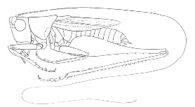
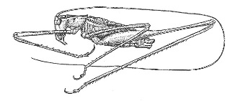
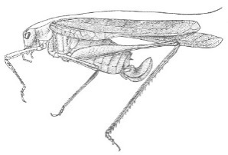
Katydids
Given a collection of annotated data. In this case 5 instances Katydids of and five of Grasshoppers, decide what type of insect the unlabeled example is.
Grasshoppers
Katydid or Grasshopper?

Slide 63
Machine Learning can be used to learn…
Who might die of a certain disease.
Which people are likely to default of their credit card loan.
Which new movies you might enjoy.
Whether or not this X-ray of a suitcase shows a bomb.
Which webpages contain pornography.
What are the likely side effects of this new drug.
The best way to route an email.
The most efficient settings for your car’s fuel injector.
Should the autonomous car hit the gas or the brake
Etc etc

Slide 64
Why is Machine Learning a hard problem?
There might be missing/noisy features.
There might be irrelevant features.
The features may be related.
It might be hard to create a good representation of the data
We might “overfit” when learning.
We might have problems with time/space complexity.
Examples of class A
People who contracted disease X.
Patients name: Dave Ho
Patient temperature 103
Blood count: unknown
Weight 407
Patients name: Dave Smith
Patient temperature 102
Blood count: 3214
Weight 445

Slide 65
That was Machine Learning … Now lets preview Knowledge Representation
(reasoning)

Slide 66
Knowledge Representation I
Suppose I tell you that…
Bob weighs 12 pounds
Bob likes to chase mice
Bob is afraid of dogs
…if someone asked you “What is Bob?”, what would you say?

Slide 67
Knowledge Representation II
This ability of humans (and to a lesser extent other animals) to be able to take a set of facts and a set of rules for manipulating facts, then to come up with new facts is at the heart of intelligence.
This is true at a high level…
Given a set of facts about physics and math, Einstein was able to come up with a new fact, E = MC²
…and a low level
Given a set of facts* about the Accounting Assistant in the CS department, I was able to come up with the fact that she is married.
* She wears a ring on her left “ring” finger.
Her business card has a last name scratched out and a new name penciled in.

Slide 68
The most Intelligent Object in the Universe
The human brain is currently the most intelligent device in the known universe.
It has held that record for perhaps a 1/2 million years (before that, whales, elephants, other primates were about as smart).
Examples:
In 1665/66 a single human mind invented/discovered most of classic physics and calculus.
In the 1850’s a single human mind discovered the explanation for the diversity of life on earth.
In 1904/5 a single human mind wrote four papers, Photoelectric effect, Brownian motion, Special relativity, Matter–energy equivalence, any one of these ideas was worth a Nobel prize.
human brain

Slide 69
The most Intelligent Object in the Universe
The human brain weights about 3lbs. Not as large as an elephant or a whale etc.
We can normalize for size in a few ways: The encephalization (EQ) level is a measure of relative brain size defined as the ratio between actual brain mass and predicted brain mass for an animal of a given size.
Mean EQ for mammals is around 1. Animals tend to have higher EQ if: They are social, they need to catch prey/have complex diets, they live in a 3D world (trees, ocean, the air).
Even given that humans are social, omnivorous and evolved from tree dwellers, we are unexpectedly large brained.
Why do human’s have big brains? (why are we so smart).
Species | EQ
Human | 7.8
Bottlenose dolphin | 4.1
Chimpanzee | 2.2
Rhesus monkey | 2.1
Elephant | 1.1
Dog | 1.2
Squirrel | 1.1
Sheep | 0.8
Mouse | 0.5
Rabbit | 0.4

