Slide 1
A brief look at Monte Carlo Methods

Slide 2
Let warm up with this old classic
What is the area of this circle?
Of course, we know a formula for it, but lets pretend we don’t.
2
0
-2
-2
0
2
pi * 2² =12.5663706144

Slide 3

Suppose I throw random darts into the square.
It might land inside the circle (a hit), or outside the circle (a miss).
Note that the probably of a hit, is in proportion to the ratio of the area of the circle and the area of the square. But I know the area of the square exactly.
So lets throw darts..

Slide 4
So lets throw darts..
I threw 1,000 darts, and 764 landed in the circle.
The area of the square is 16
So my estimate for the area of a circle is
16 * (764/1000) = 12.224
This is a good, but not great estimate.
Lets try it with more darts…
Estimate Actual Area of circle: 12.56637, Area of the circle: 12.224

Slide 5
So lets throw darts..
I threw 10,000 darts, and 7850 landed in the circle.
The area of the square is 16
So my estimate for the area of a circle is
16 * (7850/10000) = 12.5600
This is a very good estimate.

Slide 6
r=2;
c_x=0;
c_y=0;
%%position of the outer rectangle
p_x=c_x-r;
p_y=c_y-r;
pos=[p_x,p_y,r^2,r^2]
%%random number generation within the sqaure
N=1000;
a=p_x;
b=p_x+(2*r);
x = a + (b-a).*rand(N,1);
y = a + (b-a).*rand(N,1);
radii = sqrt((x-c_x).^2+(y-c_y).^2);
i = radii <= r;
hits = sum(i);
misses = N-hits;
plot(x(i),y(i),'.g’); , hold on;
plot(x(~i),y(~i),'.r');
rectangle('Position',pos,'Curvature',[1 1])
rectangle('Position',pos,'EdgeColor','r')
actual_a=pi*r^2;
title('Estimate Actual Area of circle: %1.5f, Area of the circle: %1.5f',actual_a,hits/N*(2*r)^2);

Slide 7
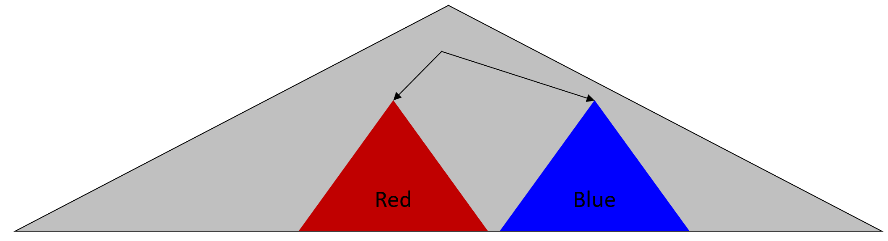
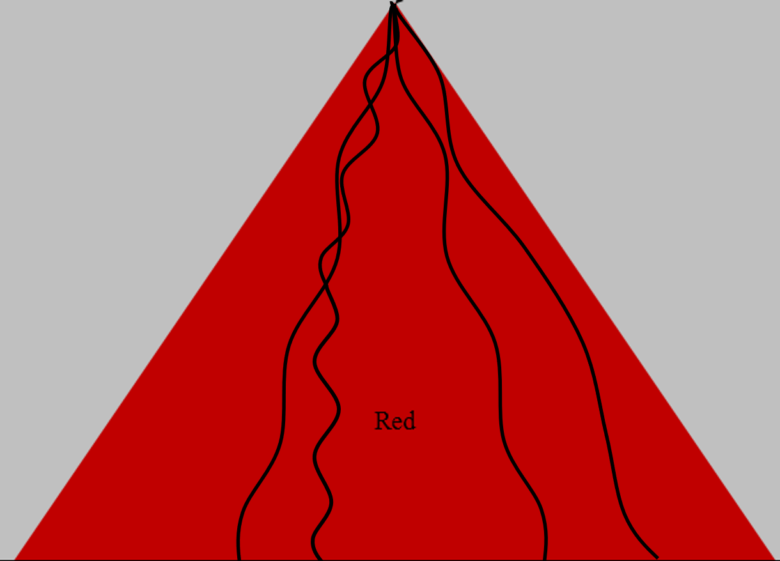
CheckPoint
Sometimes we may want to know some value.
If we can do it analytically we should.
However..
  There may be no analytic solution
  The analytic solution may take a lot of time (or memory)
  The analytic solution may be beyond our math skills
In such cases, we can try Monte Carlo Simulation
  Build a model of the system we want to examine.
  “run” the model many times with randomness from the correct distributions
  Report the aggerate results
The model can be as simple as the area of a shape, or any economic, physics, political, game, legal, biological, or weather system.
The quality of results depend on the number of random runs, and how well the system is modeled.

Slide 8
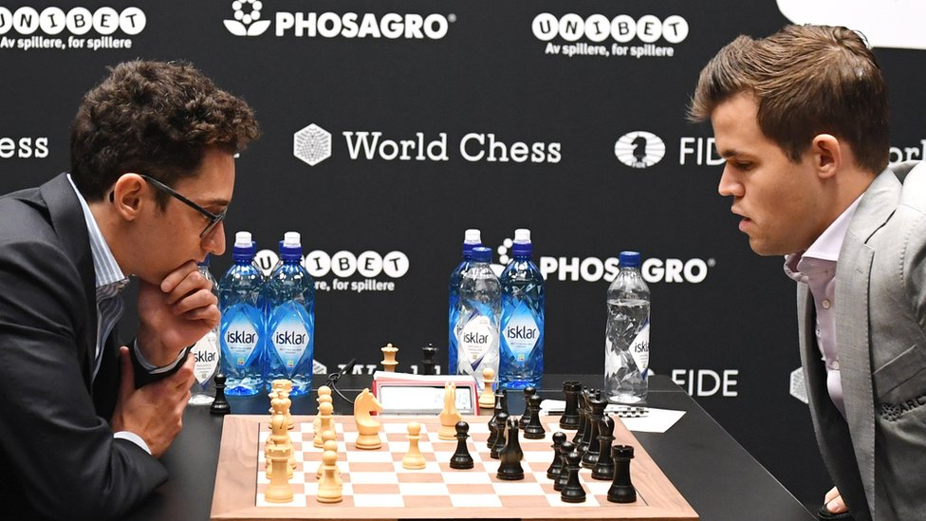
The World Chess Championship is decided over twelve games. What are the chances that the better player wins a 12-game match?
To be clear, a weaker player will sometimes win a match
  Perhaps they are having an unusually good day, and their rival is having an unusually bad day.
  While chess is mostly a game of skill, there is a small element of luck
This is why, unlike say a boxing match or a 100m sprint, the World Chess Championship is decided over 12 games.
You get
  1 point for a win
  0.5 points for a draw
The first person to get 6.5 points or greater wins
(here we ignore the rare possibility that
neither person gets 6.5 points)

Slide 9
The World Chess Championship is decided over twelve games. What are the chances that the better player wins a 12-game match?
Specifically, suppose one of the players is better than his opponent to the degree that he wins 20 percent of all games and loses 15 percent of games; the other 65 percent end in draws¹.
Here are some sample questions we may want to ask
What are the chances the better player wins a 12-game match?
How many games would a match have to be in order to give the better player a 75 percent chance of winning the match outright?
  A 90 percent chance?
  A 99 percent chance?
¹ Surprisingly you can estimate such probabilities very well with the ELO rating system

Slide 10
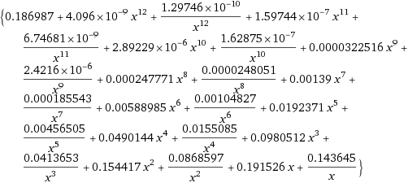
Specifically, suppose one of the players is better than his opponent to the degree that he wins 20 percent of all games and loses 15 percent of games; the other 65 percent end in draws….
Consider the following expression: (0.2x+0.65+0.15x⁻¹)¹²
The coefficients 0.2, 0.65 and 0.15 are the probabilities of the three outcomes of an individual chess game, and the whole thing is raised to the 12th power because of the 12 games of the match.
Expand (0.2x+0.65+0.15x⁻¹)¹² =
Then, the coefficient on x^{r}, where the exponent r is some integer, is the probability that the better player wins the match by r games. Finally, add the coefficients on all the positive powers of x, which gives the probability that the better player wins the match.
The result is about 0.5198, or about 52 percent.
For the second part of the problem, we can use that same approach, and just change the “12” in the exponent of the expression, and then, the same as before, expand it and sum the coefficients on the positive powers of x. The smallest exponent that gives a 75 percent chance or better is 82, the smallest that gives a 90 percent chance or better is 248, and the smallest that gives a 99 percent chance or better is 773.

Slide 11

Specifically, suppose one of the players is better than his opponent to the degree that he wins 20 percent of all games and loses 15 percent of games; the other 65 percent end in draws….
Let's simulate a contest by throwing darts, just like we did for the area of the circle..
We throw the darts at a number line, divided up to reflect the probabilities.
Here is one chess game, the better player happened to lose this game.
Nothing for BP
0
1

Slide 12
Specifically, suppose one of the players is better than his opponent to the degree that he wins 20 percent of all games and loses 15 percent of games; the other 65 percent end in draws….
Let's simulate a contest by throwing darts, just like we did for the area of the circle..
We need to play more games until
We have played 12 games
One of the players has acuminated at least 6.5 points.
Nothing for BP
0
1
½ point for BP
0
1
1 point for BP
0
1
Nothing for BP
0
1
1 point for BP
0
1
:::
0
1
0
1
0
1
0
1
0
1
0
1
Was sum of all points great than 6.5?
0
1

Slide 13
Specifically, suppose one of the players is better than his opponent to the degree that he wins 20 percent of all games and loses 15 percent of games; the other 65 percent end in draws¹.
function [ ] = chess()
runs = 10000000;
games_won =0;
for g = 1 : runs
points = 0; % white starts with no points
for i = 1 : 12 % play 12 games
dart = rand; % throw a random dart on the numberline 0 to 1
if dart < 0.2 % if dart < 0.2, white won
points = points + 1;
elseif dart < 0.85 % If the above is not true, and dart < 0.85, it was a draw
points = points + 0.5;
end
end
if points >= 6.5 % decide if white worn the whole tournament
games_won = games_won + 1;
end
end
games_won/runs
end
0
1
>> tic;, chess, toc
ans = 0.519810
Elapsed time is 3.334 seconds.
The true answer is 0.5198

Slide 14
By taking my previous code, and looping over different numbers of games, I can answer the more general questions.
1,000 runs
function [ ] = chess()
runs = 100000;
oddsOfWining=[];
for numberOfGames = 12 : 1000
games_won = 0;
for g = 1 : runs
points = 0;
for i = 1 : numberOfGames
dart = rand; %throw a random dart on the numberline 0 to 1
if dart < 0.2 % if dart < 0.2, white won
points = points + 1;
elseif dart < 0.85 % If the above is not true,
points = points + 0.5; % and dart < 0.85, it was a draw
end
end
if points >= (numberOfGames/2) + 0.5 % decide if white worn the whole tournament
games_won = games_won + 1;
end
end
oddsOfWining(numberOfGames) = games_won/runs;
end
plot(oddsOfWining)
end
  A 90 percent chance?
1,000,000 runs
248

Slide 15
Monte Carlo Methods for Politics

Slide 16
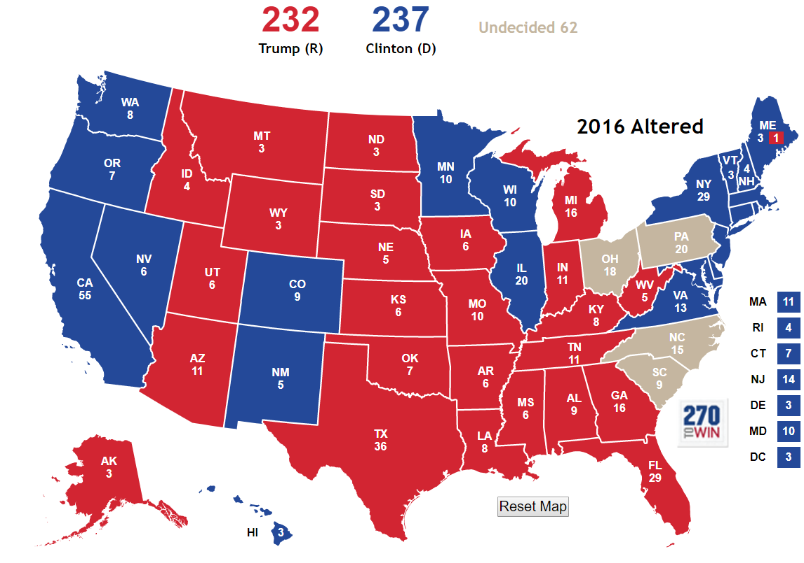
The US Presidential Election
Biden
Each state holds its own election.
A win in that state gives points to a candidate.
The number of points are proportional to the state’s population.
The first candidate to get at least 270 points is the winner.

Slide 17
The US Presidential Election
Biden
In most years, most states are “locked up”.
For example, CA is always Democratic, and Alabama is always Republican.
Thus in most election cycles, only a handful of states really matter.

Slide 18
Assume Trump runs against Biden
Further assume that all but four states are “locked up”.
The best polls give the chances of Trump winning each of the four available states as:
  OH 58%
  PA 61%
  SC 49%
  NC 51%
What is the chance that Trump wins 2024?
Biden
2024

Slide 19
Note that for each state, you must have a different random number. We are assuming each state is independent
function Election2020()
OH = 0.58;
PA = 0.61;
SC = 0.49;
NC = 0.51;
NumRuns = 100000;
NumTrumpWins = 0;
Outcome = [];
for i = 1 : NumRuns;
trump = 232;
if rand <= OH, trump = trump + 18; , end
if rand <= PA, trump = trump + 20; , end
if rand <= SC, trump = trump + 9; , end
if rand <= NC, trump = trump + 15; , end
Outcome = [Outcome trump ];
if trump >= 270
%disp(['With ',num2str(trump),' Trump wins' ])
NumTrumpWins = NumTrumpWins + 1;
else
%disp(['With only ',num2str(trump),' Trump loses' ])
end
end
disp(['Trump wins with a probability of ', num2str(NumTrumpWins/NumRuns)])
hist(Outcome,20)
unique(Outcome)
line([270 270],[0 10000],'color','r')
title(['Votes for Trump, 270 needed'])
end
Model for PA
0
0.61
1
Trump wins with a probability of 0.473

Slide 20
Trump wins with a probability of 0.473
Votes for Trump, 270 needed
Trump
10000
9000
8000
7000
6000
5000
4000
3000
2000
1000
0
230
240
250
260
270
280
290
300
232 241 247 250 252 256 259 261 265 267 270 274 276 279 285 294
Trump loses all 4
Trump loses all but SC
Trump wins all
Trump loses all but NC
Trump loses all but OH
Trump wins all except for SC
Trump wins only SC and NC
Note that there are only 16 things that can happen (they are not equally likely)

Slide 21
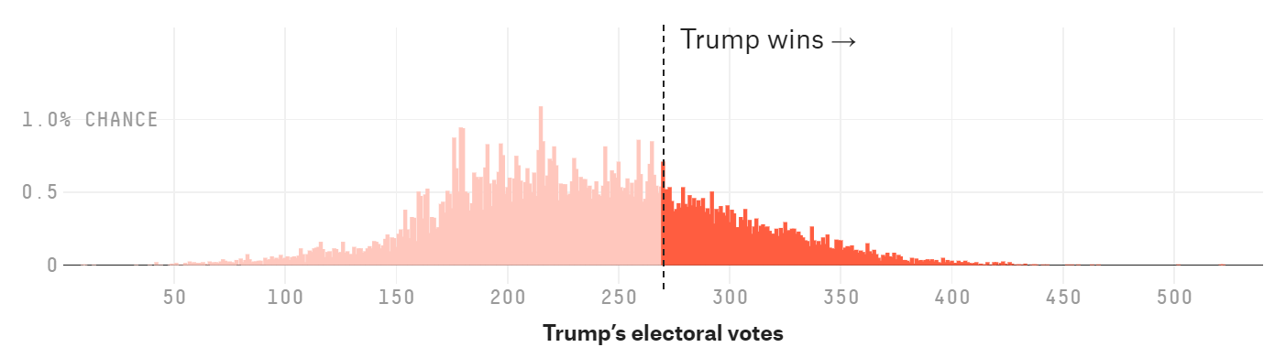
On the day of the 2016 election, virtually all “experts” gave Trump only a 5% or less chance of winning.
One group, Nate Silver’s team at fivethirtyeight.com, gave Trump a 28.6% chance of winning. At the time, this prediction was widely ridiculed as too generous to Trump.
How Nate Silver do this? He use exactly the method we used, but with all the states, here is his plot.
The model also give these probabilities
  Clinton wins popular vote 81.4% (recall this was the case)
See https://projects.fivethirtyeight.com/2016-election-forecast/

Slide 22
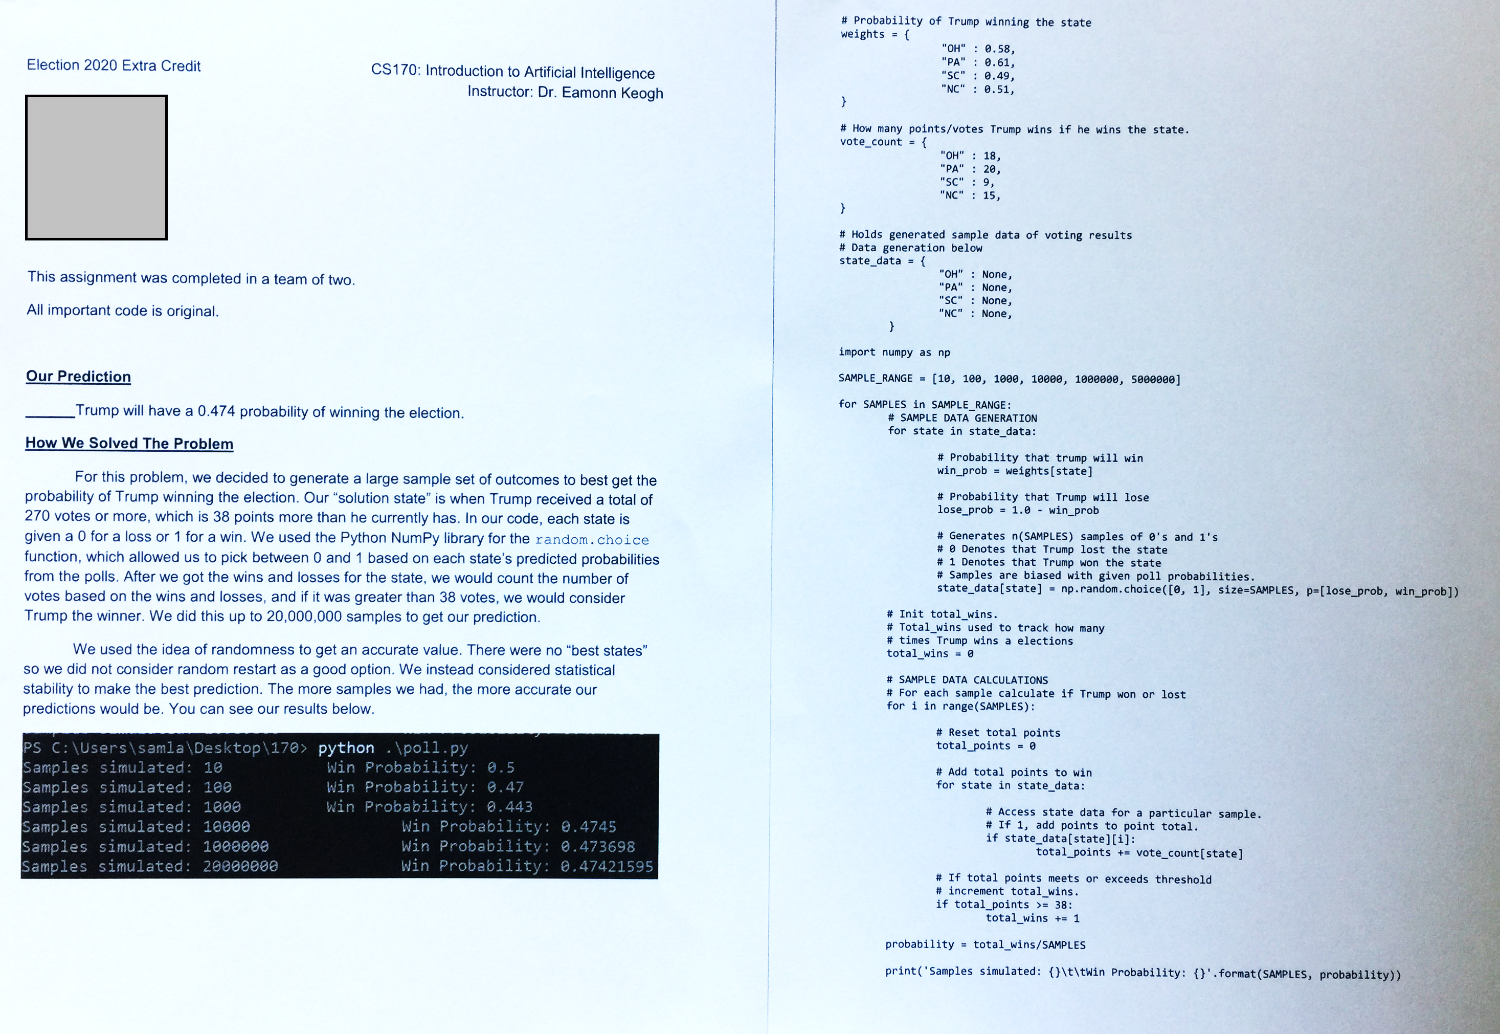

Slide 23
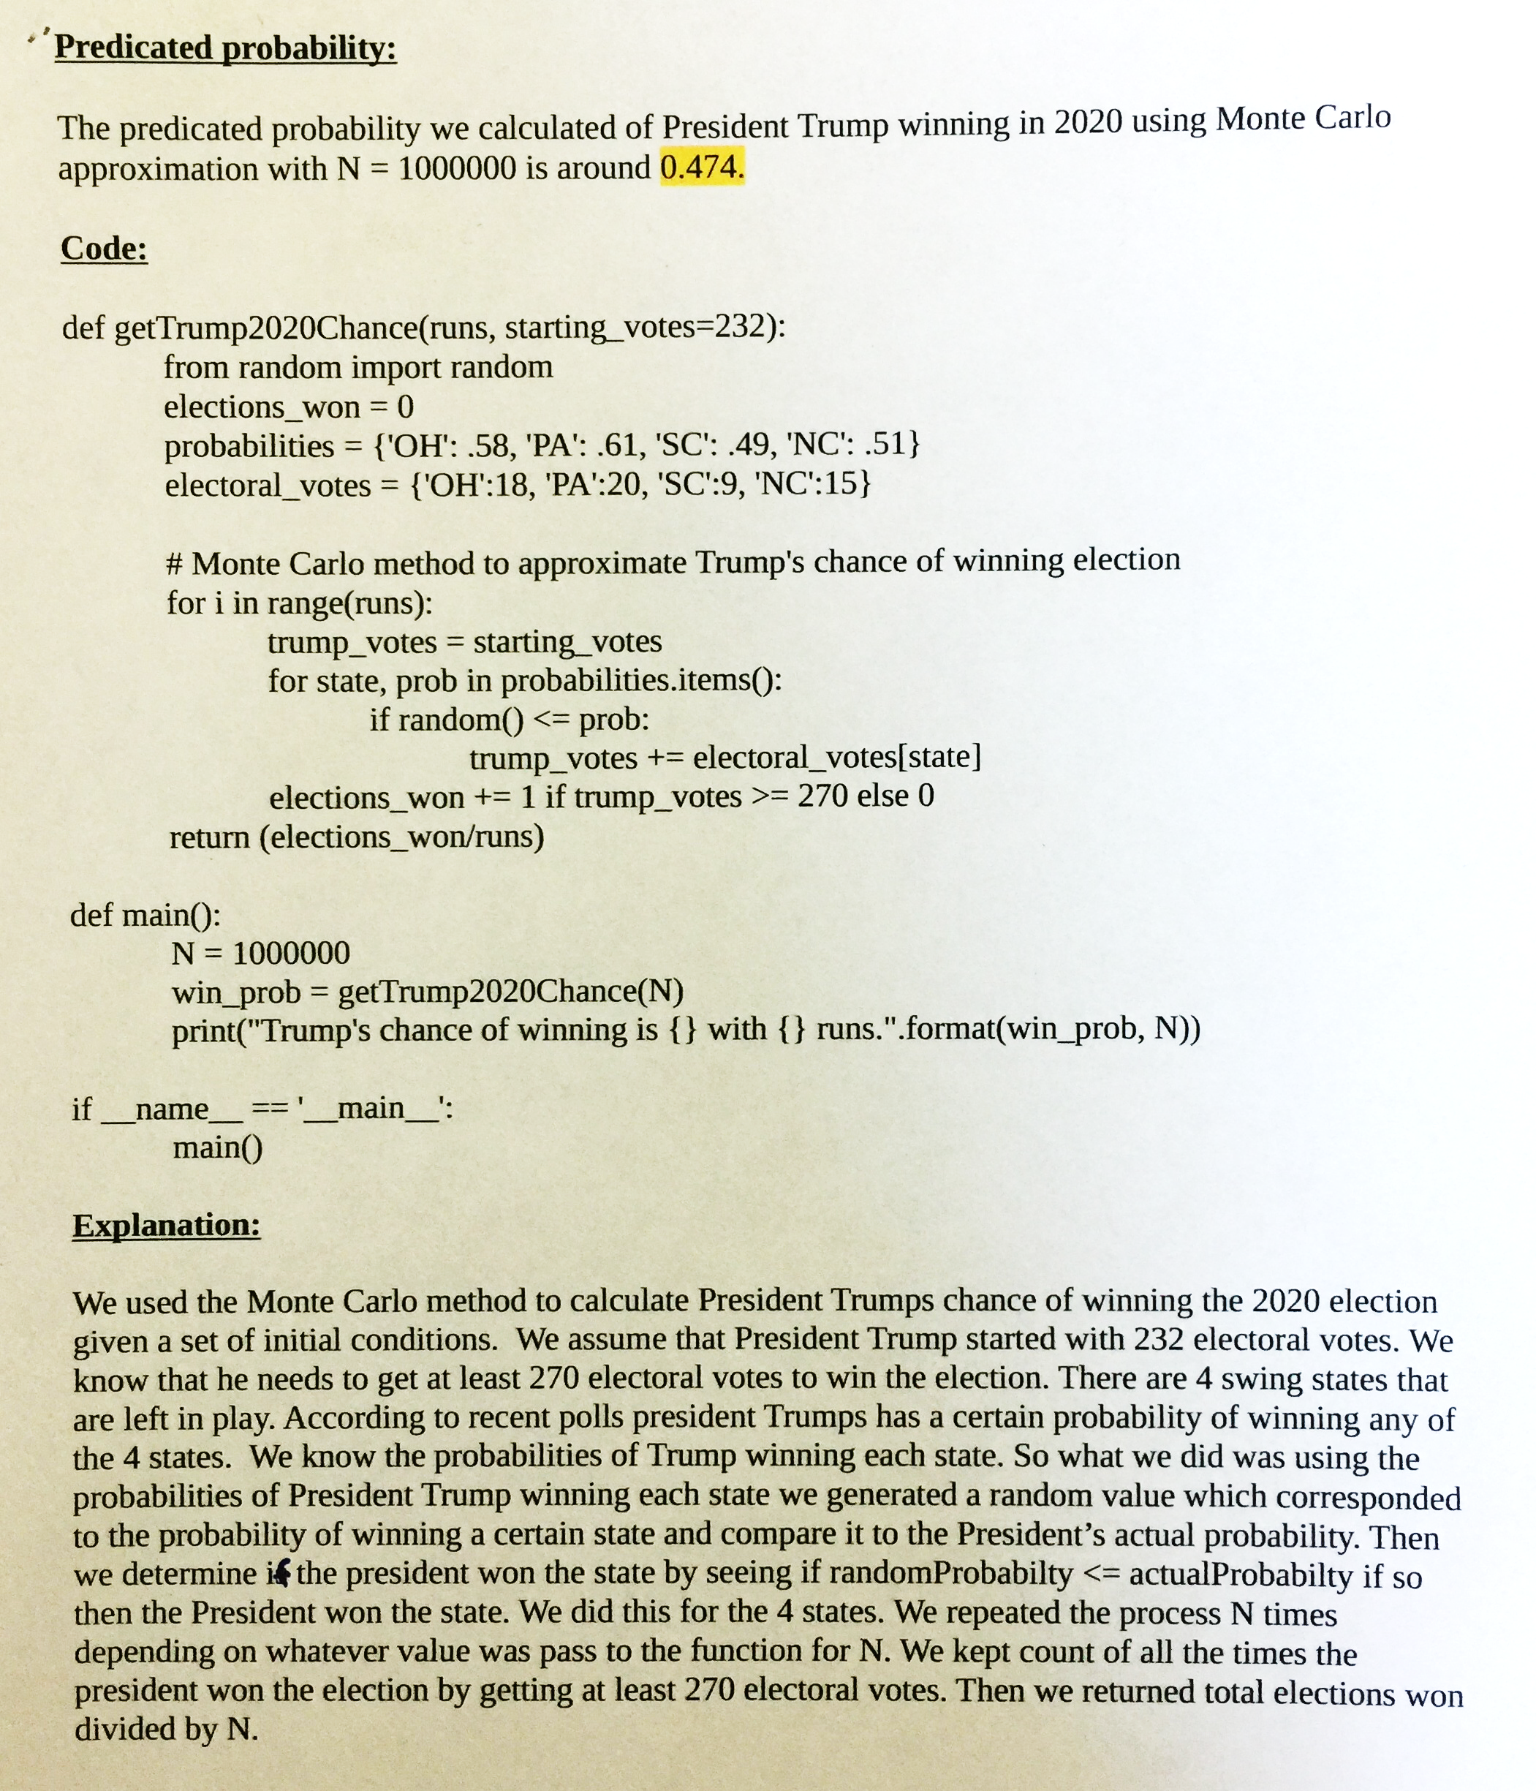

Slide 24
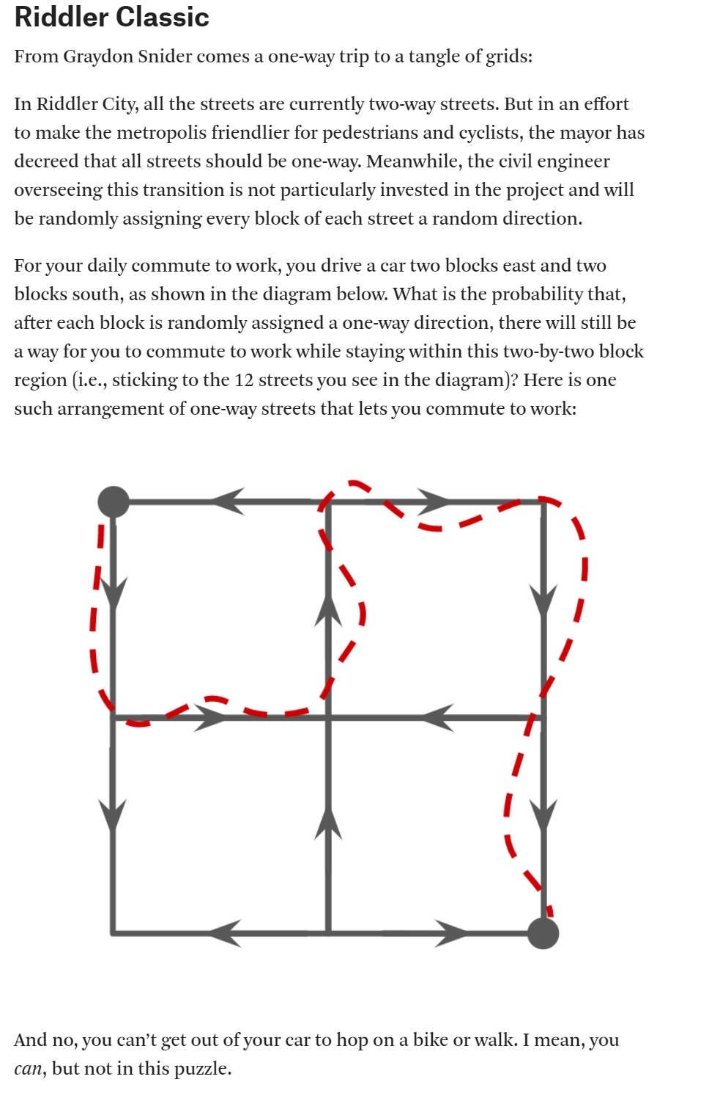
The website below has a new puzzle every week.
A significant fraction of them (including this one) can be solve with Monte Carlo methods
https://fivethirtyeight.com/tag/the-riddler/

Slide 25
Conclusions
Sometimes we may want to estimate something.
If we can do it analytically we should.
However..
  There may be no analytic solution
  The analytic solution may be beyond our math skills
In such cases, we can try Monte Carlo Simulation

Slide 26
Odds and Ends

Slide 27
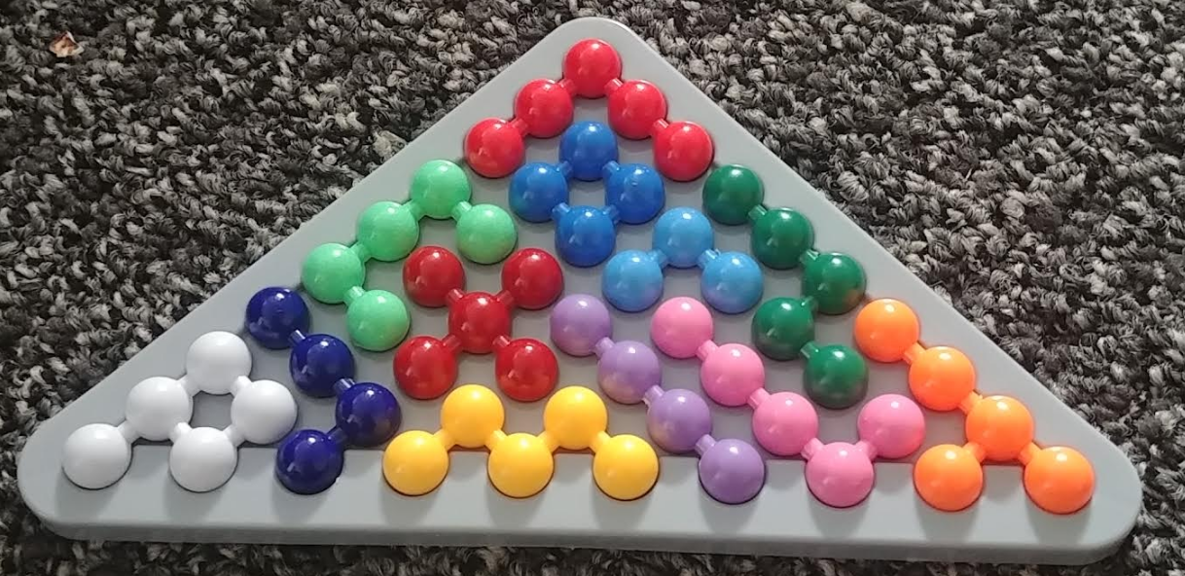
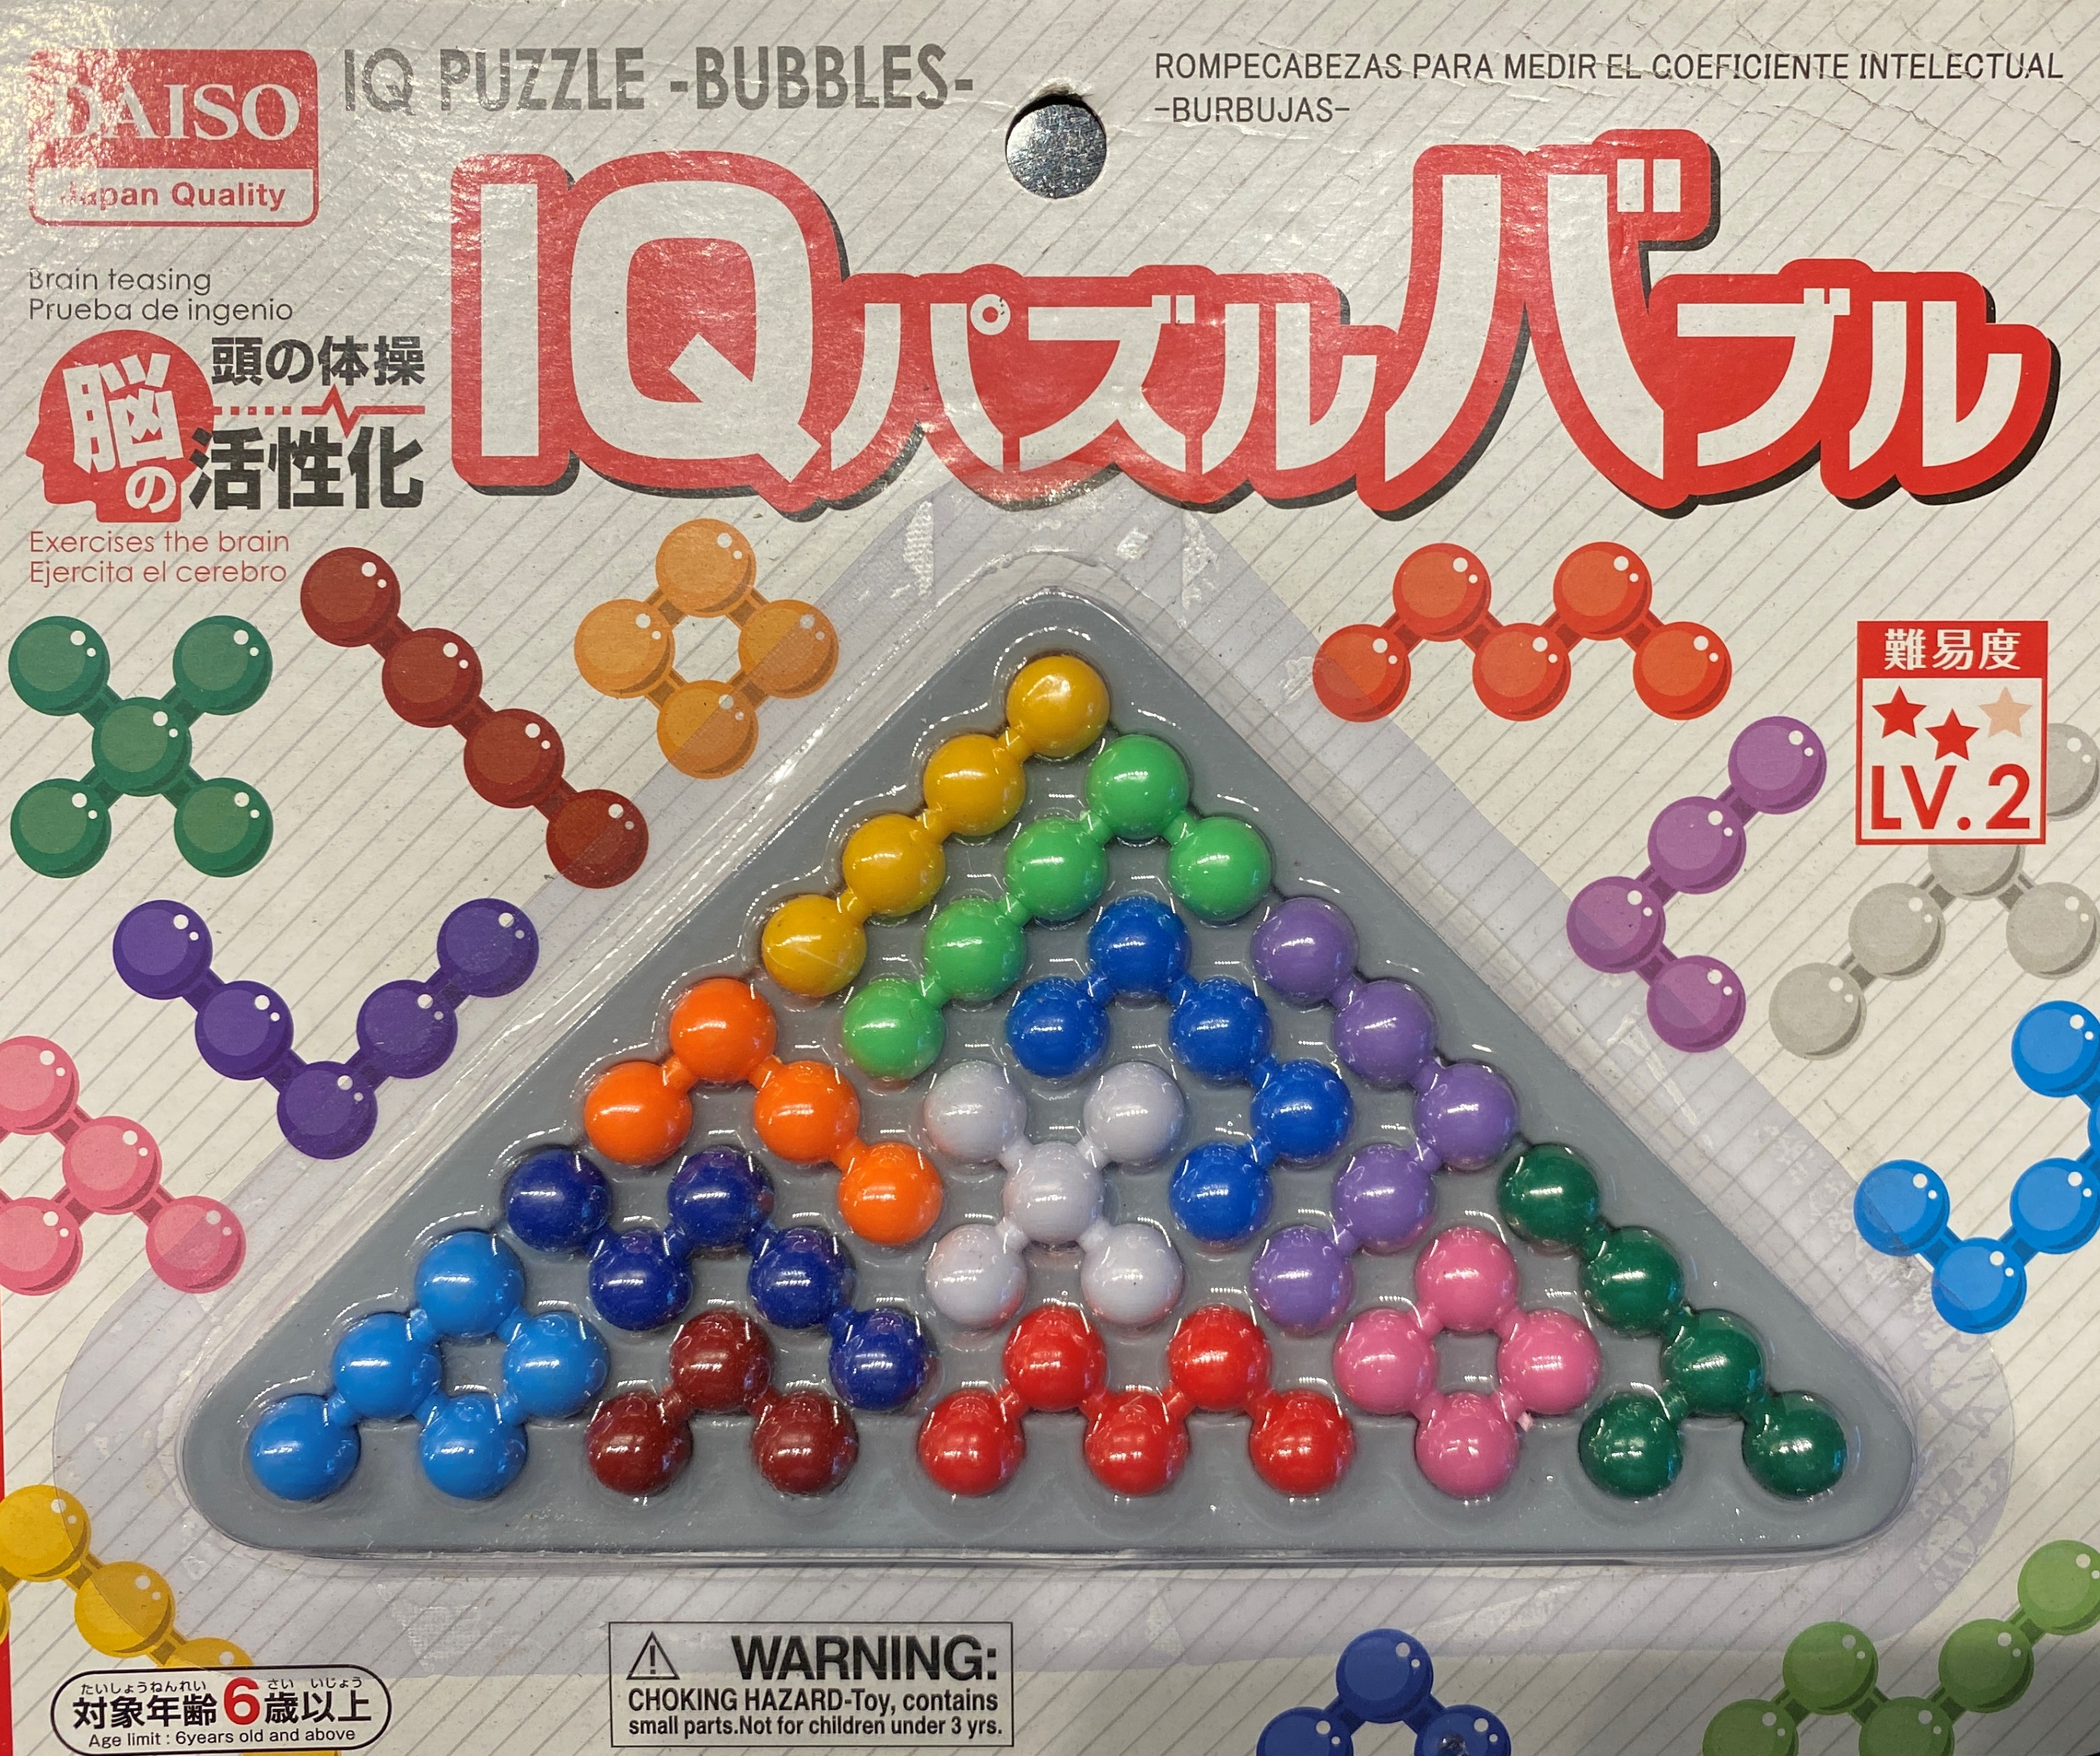
Is the solution to the Daiso Puzzle unique?
It is clear that there are at least two solutions. Because of the symmetry of the board, I can just mirror the solution on the box.
However, I was not sure if there was another non-trivial solution until my student, Jimmy Li, discovered the solution below by hand (oct-12-2021). BTW, pay attention only to the shapes. Amazingly Daiso does not keep the colors consistent from one production run to another!!
So, it is an open question, how may different solutions are there?
Jimmy Li’s solution
Original Solution and its mirror image

Slide 28
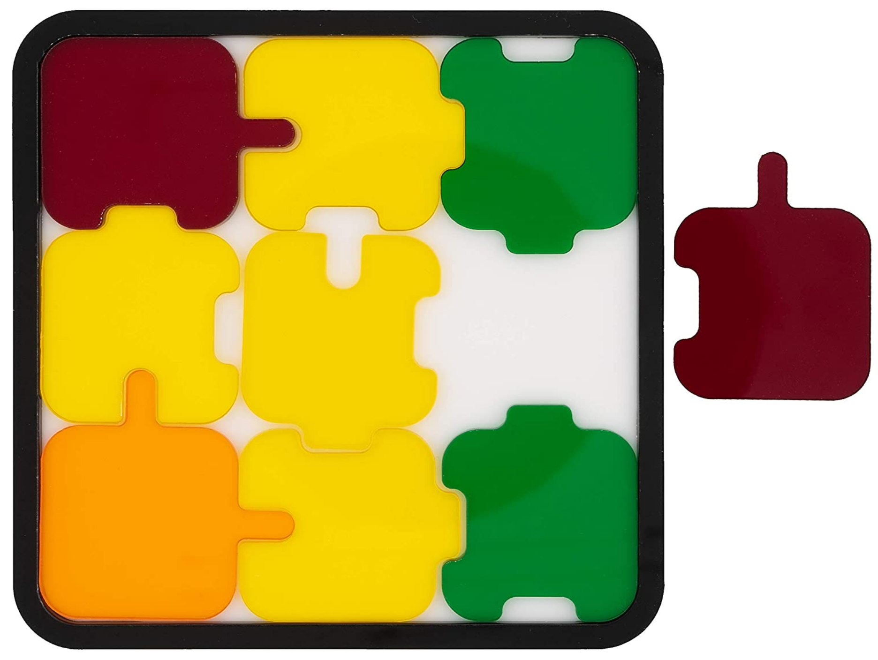
Nosey Puzzle
Locations K
1 | 2 | 3
4 | 5 | 6
7 | 8 | 9
Problem: insert all nine acrylic pieces into the frame.
Eight Operators for each part
In Location K
  Insert Part X
  Insert Part X rotated 90 degrees
  Insert Part X rotated 180 degrees
  Insert Part X rotated 270 degrees
  Insert flipped(Part X)
  Insert flipped(Part X) rotated 90 degrees
  Insert flipped(Part X) rotated 180 degrees
  Insert flipped(Part X) rotated 270 degrees

Slide 29
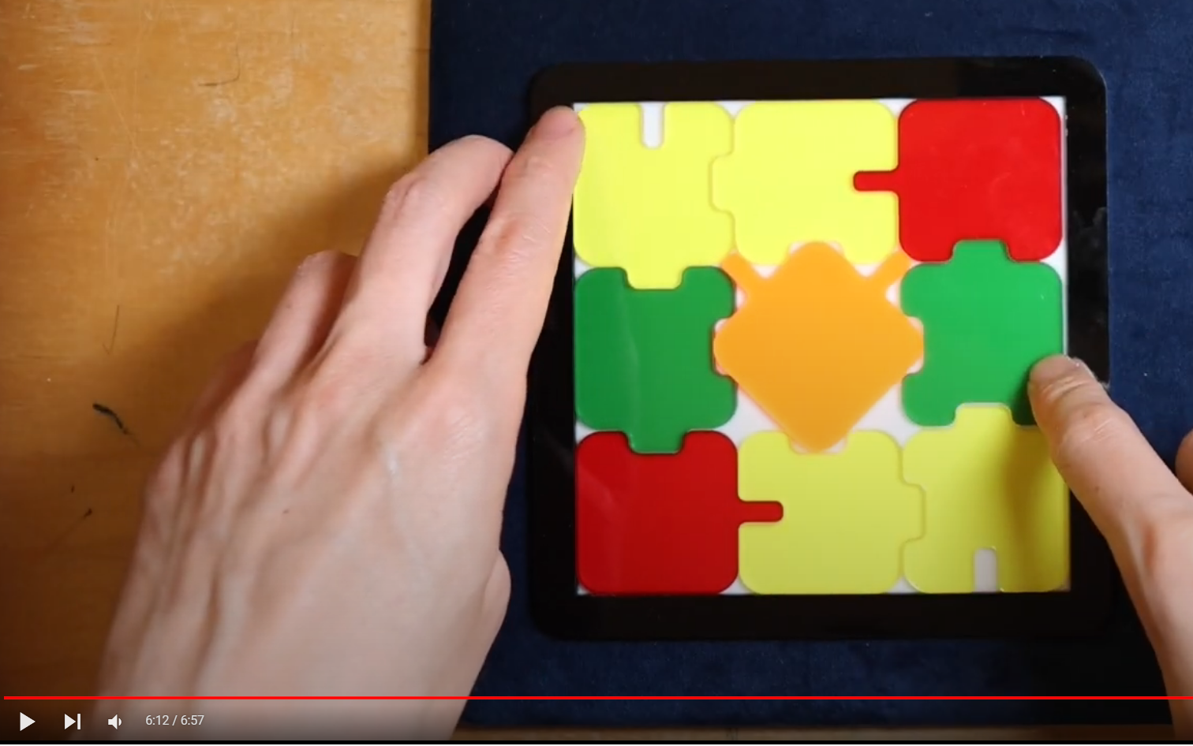
Nosey Puzzle
The puzzle is unsolvable with the eight operators I listed
There are more operators, that I did not realize I need to add
For each part
In Location K
  Insert Part X
  Insert Part X rotated 45 degrees
  Insert Part X rotated 90 degrees
  Insert Part X rotated 135 degrees
  Insert Part X rotated 180 degrees
  :::
Lesson learned
We need to be sure we have all the operators

Slide 30
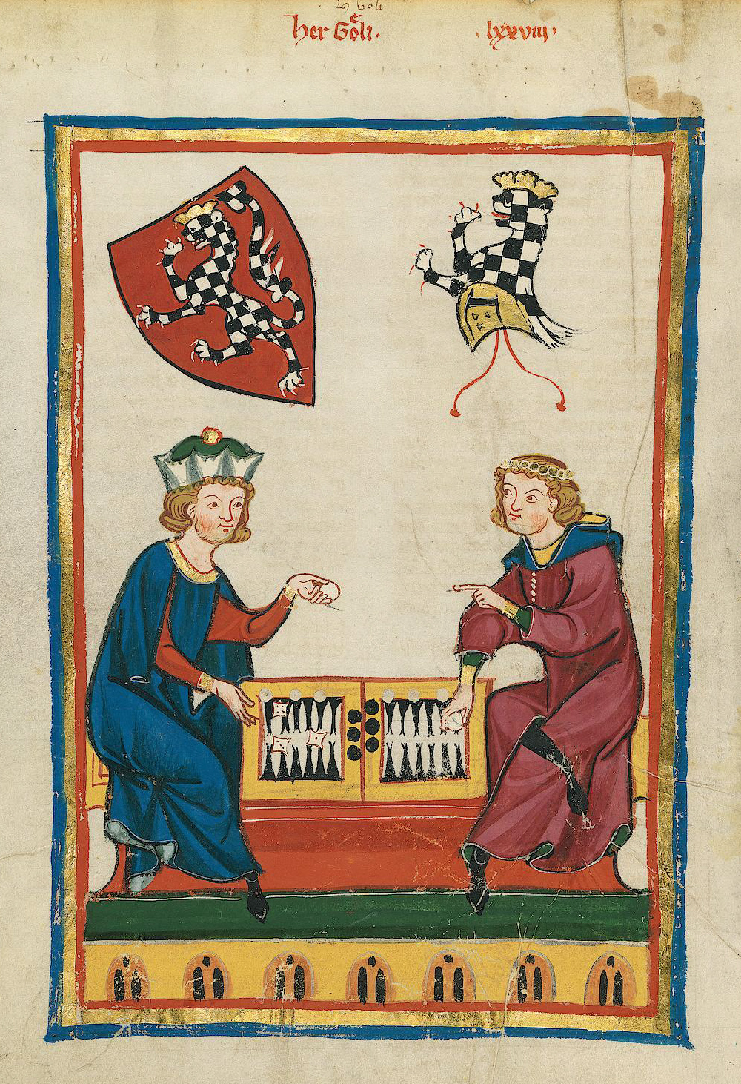
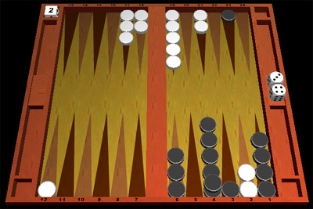
Games With Chance
Consider backgammon
  A die roll determines the moves a player can make
  Alternates moves and die rolls
Representation
  Add chance nodes to the game tree

Slide 31

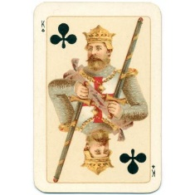
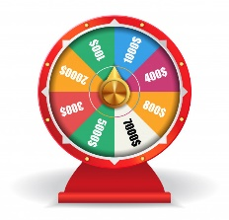
Chance Nodes
Note that different games can be:
Chance, Max, Min, Chance, Max, Min,..
Max, Chance, Min, Chance, Max, Chance, Min,..
Max, Min, Chance, Max, Min, Chance,..
We will indicate chance nodes with
Recall that we indicate Max nodes with
And Min nodes with

Slide 32



Chance Nodes
Note that different games can be:
Chance, Max, Min, Chance, Max, Min,..
Max
Chance
1/6
1
1/6
2
1/6
3
…
…
P(s) = Probability of roll
Value of roll

Slide 33



Chance Nodes
Note that different games can be:
Chance, Min, Chance Max, Chance..
Max
Chance
1/6
1
1/6
2
1/6
3
…
…
P(s) = Probability of roll
Min
Value of roll
…
…
Chance
…
…
…
…
…
…
Max
(The interleaving depends on the game)

Slide 34
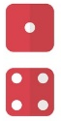
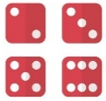
Expectminimax Value
Extend minimax (and α-β) idea to chance nodes
  Expectiminimax value
  P(s) is the probability of a random event (e.g., die roll) occurring
Time complexity
  O(b^{m}n^{m}), where n is the number of distinct events
  α-β pruning can be extended, but still enormous time complexity
  Braching Factors tend to be huge.
Example: Imagine that one outcome of a game leads to this situation. A dice is tossed. If it is a 1 or a 4, Max wins $7. If it is any other number, Max “wins” -1$.
The expected value of that move for Max is $1.66
((2/6) * 7 ) + ((4/6) * -1) = $1.66
…
$7
$-1

