Slide 1
CS/EE 217 GPU Programming and Architecture Lecture 1: Introduction

Slide 2
Course Goals
Learn how to program GPGPU processors and achieve
high performance
functionality and maintainability
scalability across future generations
Technical subjects
principles and patterns of parallel algorithms
processor architecture features and constraints
programming API, tools and techniques

Slide 3
Course Staff
Professor:
Nael Abu-Ghazaleh
WCH-441, (951) 827-2347
Use 217 to start your e-mail subject line
Office hours: TBD soon; or by appointment
Teaching Assistants:
We will have one!
If we can find one
Office hours: TBA
Class may be moving in time and space
Sorry, I will let you know soon

Slide 4
Web Resources
Course website: http://www.cs.ucr.edu/~nael/217-f15
Handouts and lecture slides
Resources, announcements, projects, …
Note: While we’ll make an effort to post announcements on the web, we can’t guarantee it, and won’t make any allowances for people who miss things in class.
Piazza for discussions
Channel for electronic announcements
Forum for Q&A – course staff read the board, and your classmates often have answers
iLearn for submissions and grades

Slide 5
Grading
Exam+Final: 35%
Labs (Programming assignments): 35%
Project: 30%
Design Document: 25%
Project Presentation: 25%
Demo/Functionality/Performance/Report: 50%

Slide 6
Academic Honesty
You are allowed and encouraged to discuss assignments with other students in the class. Getting verbal advice/help from people who’ve already taken the course is also fine.
Any reference to assignments from previous terms or web postings is unacceptable
Any copying of non-trivial code is unacceptable
Non-trivial = more than a line or so
Includes reading someone else’s code and then going off to write your own.

Slide 7
Academic Honesty (cont.)
Giving/receiving help on an exam is unacceptable
Penalties for academic dishonesty:
Zero on the assignment for the first occasion
Automatic failure of the course for repeat offenses
UCR academic honesty policy trumps any instructor policies

Slide 8
Team Projects
Work can be divided up between team members in any way that works for you
However, each team member will demo the final checkpoint of each project individually, and will get a separate demo grade
This will include questions on the entire design
Rationale: if you don’t know enough about the whole design to answer questions on it, you aren’t involved enough in the project

Slide 9
Text/Notes
D. Kirk and W. Hwu, “Programming Massively Parallel Processors – A Hands-on Approach, Second Edition”
CUDA by example, Sanders and Kandrot
Nvidia CUDA C Programming Guide
https://docs.nvidia.com/cuda/cuda-c-programming-guide/
Occasional research papers
Lecture notes on class website
Tentative schedule on class website
Will try to assign reading ahead of time

Slide 10
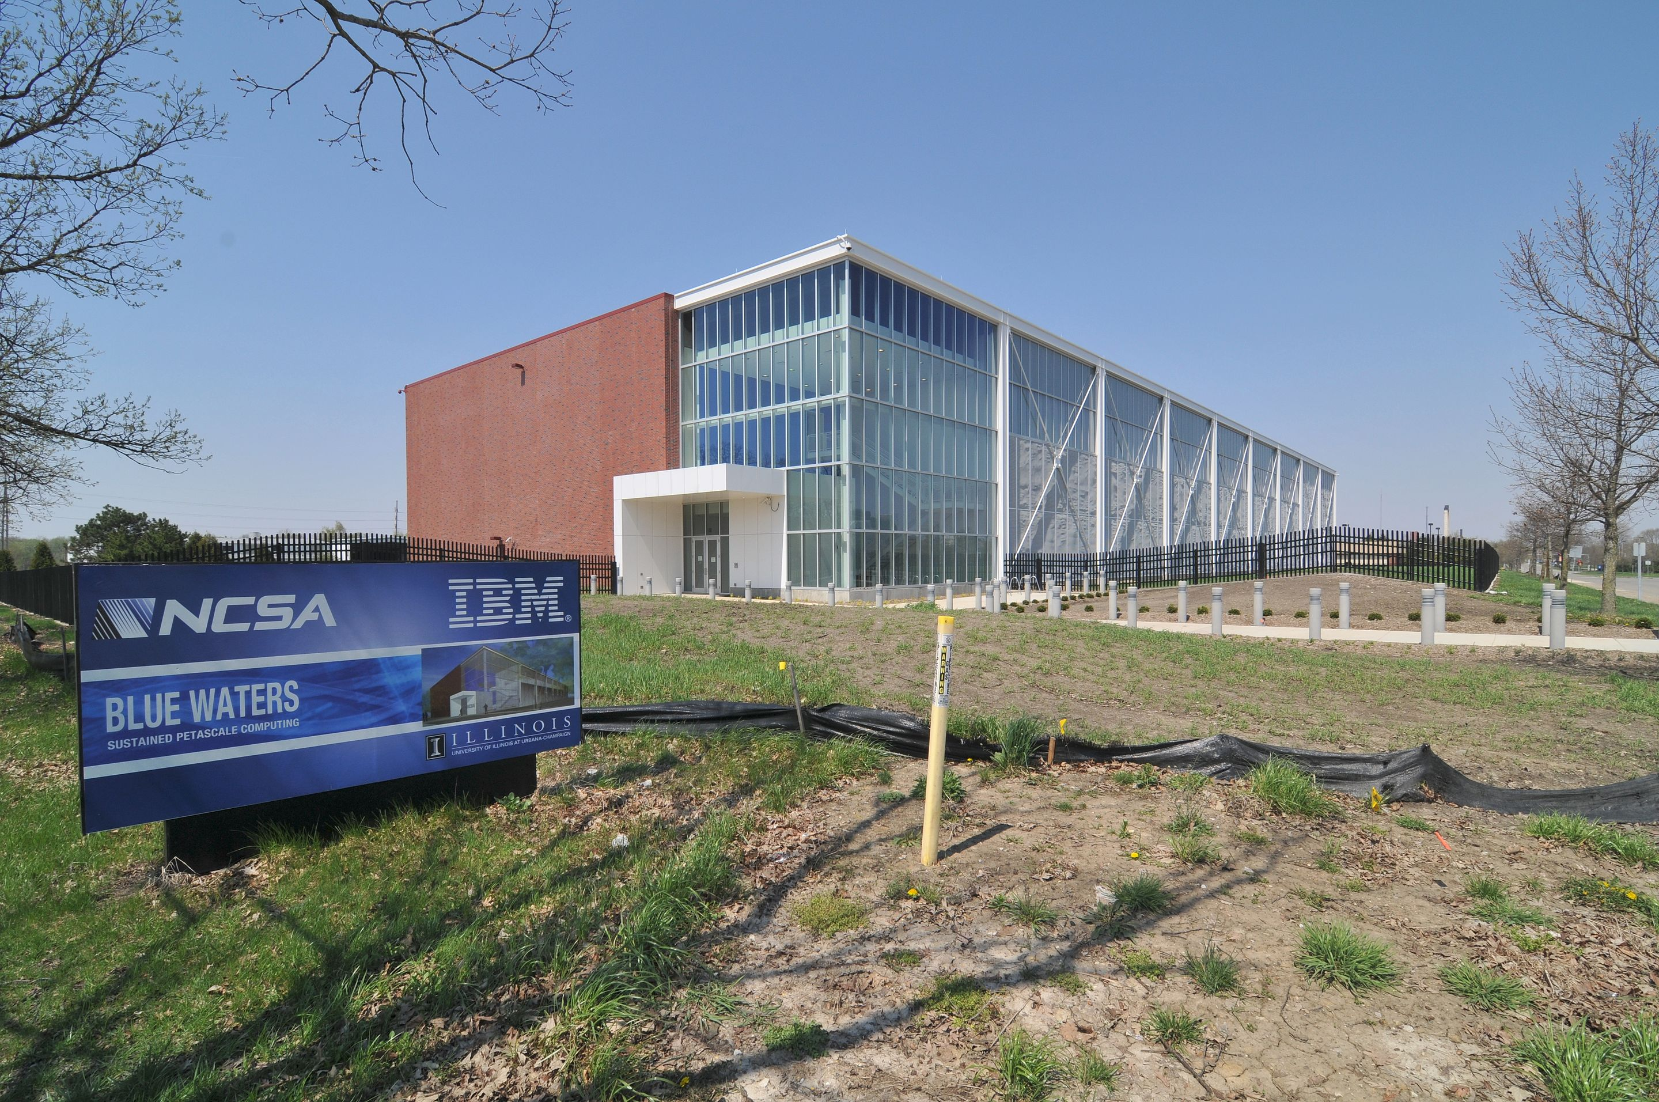
Blue Waters Hardware
Cray System & Storage cabinets:
>300
Compute nodes:
>25,000
Usable Storage Bandwidth:
>1 TB/s
System Memory:
>1.5 Petabytes
Memory per core module:
4 GB
Gemin Interconnect Topology:
3D Torus
Usable Storage:
>25 Petabytes
Peak performance:
>11.5 Petaflops
Number of AMD Interlogos processors:
>49,000
Number of AMD x86 core modules:
>380,000
Number of NVIDIA Kepler GPUs:
>3,000

Slide 11
Cray XK7 Compute Node
PCIe Gen2
XK7 Compute Node Characteristics
AMD Series 6200 (Interlagos)
NVIDIA Kepler
Host Memory 32GB 1600 MT/s DDR3
NVIDIA Tesla X2090 Memory 6GB GDDR5 capacity
Gemini High Speed Interconnect
Keplers in final installation
HT3
HT3
Z
Y
X

Slide 12
CPU and GPU have very different design philosophy
GPU
Throughput Oriented Cores
CPU
Latency Oriented Cores
Chip
Chip
Compute Unit
Core
Cache/Local Mem
Local Cache
Registers
SIMD Unit
Threading
Registers
Control
SIMD Unit

Slide 13
CPUs: Latency Oriented Design
Large caches
Convert long latency memory accesses to short latency cache accesses
Sophisticated control
Branch prediction for reduced branch latency
Data forwarding for reduced data latency
Powerful ALU
Reduced operation latency
Control
ALU
ALU
ALU
ALU
CPU
Cache
DRAM

Slide 14
GPUs: Throughput Oriented Design
Small caches
To boost memory throughput
Simple control
No branch prediction
No data forwarding
Energy efficient ALUs
Many, long latency but heavily pipelined for high throughput
Require massive number of threads to tolerate latencies
GPU
DRAM

Slide 15
Heterogeneous Computing: Use Both CPU and GPU
CPUs for sequential parts where latency matters
CPUs can be 10+X faster than GPUs for sequential code
GPUs for parallel parts where throughput wins
GPUs can be 10+X faster than CPUs for parallel code

Slide 16
Heterogeneous parallel computing is catching on.
Financial Analysis
Scientific Simulation
Engineering Simulation
Data Intensive Analytics
Medical Imaging
Digital Audio Processing
Digital Video Processing
Computer Vision
Biomedical Informatics
Electronic Design Automation
Statistical Modeling
Ray Tracing Rendering
Interactive Physics
Numerical Methods
280 submissions to GPU Computing Gems
110 articles included in two volumes

Slide 17
Parallel Programming Work Flow
Identify compute intensive parts of an application
Adopt scalable algorithms
Optimize data arrangements to maximize locality
Performance Tuning
Pay attention to code portability and maintainability

Slide 18
Software Dominates System Cost
SW lines per chip increases at 2x/10 months
HW gates per chip increases at 2x/18 months
Future system must minimize software redevelopment

Slide 19
Keys to Software Cost Control
App
Scalability
Core A

Slide 20
Keys to Software Cost Control
App
Scalability
The same application runs efficiently on new generations of cores
Core A
Core A 2.0

Slide 21
Keys to Software Cost Control
App
Scalability
The same application runs efficiently on new generations of cores
The same application runs efficiently on more of the same cores
Core A
Core A
Core A

Slide 22
Scalability and Portability
Performance growth with HW generations
Increasing number of compute units
Increasing number of threads
Increasing vector length
Increasing pipeline depth
Increasing DRAM burst size
Increasing number of DRAM channels
Increasing data movement latency
Portability across many different HW types
Multi-core CPUs vs. many-core GPUs
VLIW vs. SIMD vs. threading
Shared memory vs. distributed memory

Slide 23
Keys to Software Cost Control
App
App
App
Scalability
Portability
The same application runs efficiently on different types of cores
Core B
Core A
Core C

Slide 24
Keys to Software Cost Control
App
App
App
Scalability
Portability
The same application runs efficiently on different types of cores
The same application runs efficiently on systems with different organizations and interfaces

Slide 25
Parallelism Scalability

Slide 26
Algorithm Complexity and Data Scalability

Slide 27
Why is data scalability important?
Any algorithm complexity higher than linear is not data scalable
Execution time explodes as data size grows even for an n*log(n) algorithm
Processing large data sets is a major motivation for parallel computing
A sequential algorithm with linear data scalability can outperform a parallel algorithm with n*log(n) complexity
log(n) grows to be greater than degree of HW parallelism and makes parallel algorithm run slower than sequential algorithm

Slide 28
Parallelism cannot overcome complexity for large data sets

Slide 29
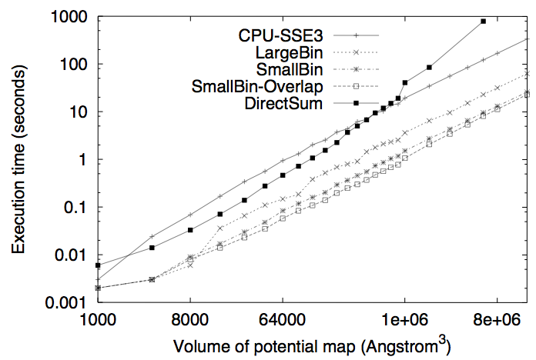
A Real Example of Data Scalability Particle-Mesh Algorithms

Slide 30
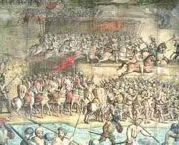
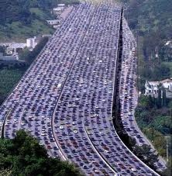
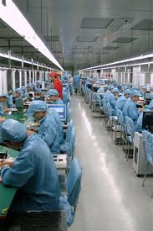
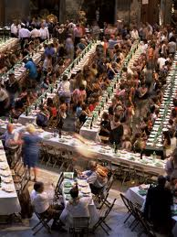
Massive Parallelism - Regularity

Slide 31
Load Balance
The total amount of time to complete a parallel job is limited by the thread that takes the longest to finish
good
bad!

Slide 32
Global Memory Bandwidth
Ideal
Reality

Slide 33
Conflicting Data Accesses Cause Serialization and Delays
Massively parallel execution cannot afford serialization
Contentions in accessing critical data causes serialization

Slide 34
What is the stake?
Scalable and portable software lasts through many hardware generations
Scalable algorithms and libraries can be the best legacy we can leave behind from this era

Slide 35
Questions?

