Slide 1
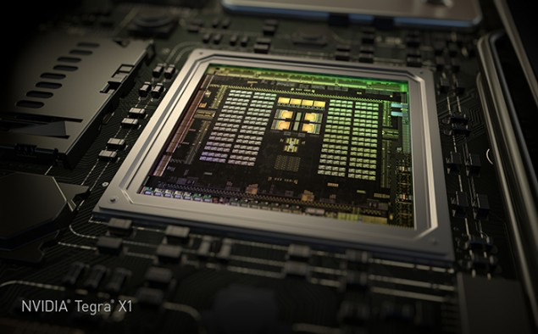
GPU Computing Architecture
/
Slide credits: most slides from tutorial by Tor Aamodt (UBC, GPGPUSim). Additional material from NViDia whitepaper, and others
NVIDIA Tegra X1 die photo

Slide 2
The GPU is Ubiquitous
+
[APU13 keynote]

Slide 3
“Early” GPU History
1981: IBM PC Monochrome Display Adapter (2D)
1996: 3D graphics (e.g., 3dfx Voodoo)
1999: register combiner (NVIDIA GeForce 256)
2001: programmable shaders (NVIDIA GeForce 3)
2002: floating-point (ATI Radeon 9700)
2005: unified shaders (ATI R520 in Xbox 360)
2006: compute (NVIDIA GeForce 8800)
Notes:
GPGPU
Origins
Use in supercomputing
CUDA => OpenCL => C++AMP, OpenACC, others
Use in Smartphones (e.g., Imagination PowerVR)
Cars (e.g., NVIDIA DRIVE PX)

Slide 4
GPU: The Life of a Triangle
+
process commands
Host
/
Front End
/
Vertex Fetch
transform vertices
Vertex Processing
to screen
-
space
generate per
-
Primitive Assembly
,
Setup
triangle equations
r
e
l
l
generate pixels
o
,
delete pixels
Rasterize
&
Zcull
r
t
that cannot be seen
n
o
C
Pixel Shader
r
e
f
f
u
determine the colors
B
,
transparencies
Texture
e
and depth of the pixel
m
a
r
F
do final hidden surface test,
blend
Pixel Engines
and write out color and new depth
(
ROP
)
[David Kirk / Wen-mei Hwu]

Slide 5
pixel color result of running “shader” program
+
Notes:
Each pixel the result of a single thread run on the GPU

Slide 6
Why use a GPU for computing?
GPU uses larger fraction of silicon for computation than CPU.
At peak performance GPU uses order of magnitude less energy per operation than CPU.
CPU
2nJ/op
GPU
200pJ/op
Rewrite Application
Order of Magnitude More Energy Efficient
e.g., paper in ISCA 2010 shows average speedup for throughput bound applications over core i7 is 2.5 x
However….
Application must perform well

Slide 7
Growing Interest in GPGPU
Supercomputing – Green500.org Nov 2014
“the top three slots of the Green500 were powered by three different accelerators with number one, L-CSC, being powered by AMD FirePro™ S9150 GPUs; number two, Suiren, powered by PEZY-SC many-core accelerators; and number three, TSUBAME-KFC, powered by NVIDIA K20x GPUs. Beyond these top three, the next 20 supercomputers were also accelerator-based.”
Deep Belief Networks map very well to GPUs (e.g., Google keynote at 2015 GPU Tech Conf.)
http://blogs.nvidia.com/blog/2015/03/18/google-gpu/
http://www.ustream.tv/recorded/60071572

Slide 8
Part 1: Preliminaries and Instruction Set Architecture

Slide 9
GPGPUs vs. Vector Processors
Similarities at hardware level between GPU and vector processors.
(I like to argue) SIMT programming model moves hardest parallelism detection problem from compiler to programmer.

Slide 10
GPU Instruction Set Architecture (ISA)
NVIDIA defines a virtual ISA, called “PTX” (Parallel Thread eXecution)
More recently, Heterogeneous System Architecture (HSA) Foundation (AMD, ARM, Imagination, Mediatek, Samsung, Qualcomm, TI) defined the HSAIL virtual ISA.
PTX is Reduced Instruction Set Architecture (e.g., load/store architecture)
Virtual: infinite set of registers (much like a compiler intermediate representation)
PTX translated to hardware ISA by backend compiler (“ptxas”). Either at compile time (nvcc) or at runtime (GPU driver).

Slide 11
Some Example PTX Syntax
Registers declared with a type:
.reg .pred p, q, r;
.reg .u16 r1, r2;
.reg .f64 f1, f2;
ALU operations
add.u32 x, y, z; // x = y + z
mad.lo.s32 d, a, b, c; // d = a*b + c
Memory operations:
ld.global.f32 f, [a];
ld.shared.u32 g, [b];
st.local.f64 [c], h
Compare and branch operations:
setp.eq.f32 p, y, 0; // is y equal to zero?
@p bra L1 // branch to L1 if y equal to zero

Slide 12
Part 2: Generic GPGPU Architecture

Slide 13
Extra resources
GPGPU-Sim 3.x Manual
http://gpgpu-sim.org/manual/index.php/GPGPU-Sim_3.x_Manual

Slide 14
GPU Microarchitecture Overview
Single-Instruction, Multiple-Threads
GPU
SIMT Core Cluster
SIMT Core Cluster
SIMT Core Cluster
SIMT
Core
SIMT
Core
SIMT
Core
SIMT
Core
SIMT
Core
SIMT
Core
Interconnection Network
Memory
Partition
Memory
Partition
Memory
Partition
GDDR5
GDDR5
Off-chip DRAM
GDDR5

Slide 16
GPU Microarchitecture
Companies tight lipped about details of GPU microarchitecture.
Several reasons:
Competitive advantage
Fear of being sued by “non-practicing entities”
The people that know the details too busy building the next chip
Model described next, embodied in GPGPU-Sim, developed from: white papers, programming manuals, IEEE Micro articles, patents.

Slide 17
GPU Microarchitecture Overview
GPU
SIMT Core Cluster
SIMT Core Cluster
SIMT Core Cluster
SIMT
Core
SIMT
Core
SIMT
Core
SIMT
Core
SIMT
Core
SIMT
Core
Interconnection Network
Memory
Partition
Memory
Partition
Memory
Partition
GDDR3/GDDR5
GDDR3/GDDR5
Off-chip DRAM
GDDR3/GDDR5

Slide 18
Inside a SIMT Core
SIMT
Front End
Reg
File
SIMD Datapath
Fetch
Decode
Memory Subsystem
Icnt.
Network
Schedule
Branch
SMem
L1 D$
Tex $
Const$
SIMT front end / SIMD backend
Fine-grained multithreading
Interleave warp execution to hide latency
Register values of all threads stays in core

Slide 19
Inside an “NVIDIA-style” SIMT Core
SIMT Front End
SIMD Datapath
Branch Target PC
Fetch
SIMT-Stack
Scheduler 1
Scheduler 3
ALU
Valid[1:N]
Active
ALU
I-Buffer
Pred.
ALU
Mask
ALU
I-Cache
Decode
Issue
Operand
Scheduler 2
Collector
Score
MEM
Board
Done (WID)
Three decoupled warp schedulers
Scoreboard
Large register file
Multiple SIMD functional units

Slide 20
Fetch + Decode
Arbitrate the I-cache among warps
Cache miss handled by fetching again later
Fetched instruction is decoded and then stored in the I-Buffer
1 or more entries / warp
Only warp with vacant entries are considered in fetch
Score-
PC
Decode
Board
A
1
PC
v
Inst. W1
r
R
2
e
B
PC
3
v
Inst. W2
r
h
c
v
Inst. W3
r
a
C
-
I
o
Selection
T
To
Fetch
Issue
Valid[1:N]
Issue
ARB
Fetch
Valid[1:N]
I-Buffer
I-Cache
Decode

Slide 21
Instruction Issue
Select a warp and issue an instruction from its I-Buffer for execution
Scheduling: Greedy-Then-Oldest (GTO)
GT200/later Fermi/Kepler: Allow dual issue (superscalar)
Fermi: Odd/Even scheduler
To avoid stalling pipeline might
keep instruction in I-buffer until
know it can complete (replay)

Slide 22
Review: In-order Scoreboard
+
Scoreboard: a bit-array, 1-bit for each register
If the bit is not set: the register has valid data
If the bit is set: the register has stale data
i.e., some outstanding instruction is going to change it
Issue in-order: RD ← Fn (RS, RT)
If SB[RS] or SB[RT] is set → RAW, stall
If SB[RD] is set → WAW, stall
Else, dispatch to FU (Fn) and set SB[RD]
Complete out-of-order
Update GPR[RD], clear SB[RD]
Scoreboard
Register File
0
Regs[R1]
1
Regs[R2]
0
Regs[R3]
0
Regs[R31]
[Gabriel Loh]
Notes:
H&P-style notation

Slide 23
In-Order Scoreboard for GPUs?
+
Problem 1: 32 warps, each with up to 128 (vector) registers per warp means scoreboard is 4096 bits.
Problem 2: Warps waiting in I-buffer needs to have dependency updated every cycle.
Solution?
Flag instructions with hazards as not ready in I-Buffer so not considered by scheduler
Track up to 6 registers per warp (out of 128)
I-buffer 6-entry bitvector: 1b per register dependency
Lookup source operands, set bitvector in I-buffer. As results written per warp, clear corresponding bit

Slide 24
Example
+
Code
ld r7, [r0]
mul r6, r2, r5
add r8, r6, r7
Scoreboard
Instruction Buffer
Index 0
Index 1
Index 2
Index 3
i0 i1 i2 i3
Warp 0
r7 | - | - | -
- | - | - | -
r7 | r6 | - | -
- | - | - | -
r7 | r6 | r8 | -
- | - | - | -
r7 | r6 | r8 | -
- | - | - | -
r7 | - | r8 | -
- | - | - | -
r7 | - | r8 | -
- | - | - | -
- | - | r8 | -
- | - | - | -
Warp 0
- | - | - | -
- | - | - | -
ld r7, [r0] | 0 | 0 | 0 | 0
ld r7, [r0] | 0 | 0 | 0 | 0
mul r6, r2, r5 | 0 | 0 | 0 | 0
ld r7, [r0] | 0 | 0 | 0 | 0
mul r6, r2, r5 | 0 | 0 | 0 | 0
add r8, r6, r7 | 1 | 1 | 0 | 0
ld r7, [r0] | 0 | 0 | 0 | 0
mul r6, r2, r5 | 0 | 0 | 0 | 0
add r8, r6, r7 | 1 | 1 | 0 | 0
ld r7, [r0] | 0 | 0 | 0 | 0
add r8, r6, r7 | 1 | 0 | 0 | 0
ld r7, [r0] | 0 | 0 | 0 | 0
add r8, r6, r7 | 1 | 0 | 0 | 0
add r8, r6, r7 | 0 | 0 | 0 | 0
Warp 1
Warp 1

Slide 25
SIMT Using a Hardware Stack
Stack approach invented at Lucafilm, Ltd in early 1980’s
Version here from [Fung et al., MICRO 2007]
Stack
A
A/1111
Reconv. PC
Next PC
Active Mask
TOS
TOS
TOS
TOS
-
-
-
-
-
-
-
G
A
E
E
B
E
E
1111
1111
1111
1111
1111
1111
1111
E
E
D
D
0110
TOS
E
D
0110
0110
B
B/1111
TOS
TOS
E
E
C
E
1001
1001
C/1001
D/0110
C
D
F
Thread Warp
Common PC
E
E/1111
Thread
1
Thread
2
Thread
3
Thread
4
G
G/1111
A
B
C
D
E
G
A
Time
SIMT = SIMD Execution of Scalar Threads

Slide 26
SIMT Notes
Execution mask stack implemented with special instructions to push/pop. Descriptions can be found in AMD ISA manual and NVIDIA patents.
In practice augment stack with predication (lower overhead).

Slide 27
How is this done?
Consider the following code:
if(X[i] != 0)
X[i] = X[i] – Y[i];
else X[i] = Z[i];
What does this compile to?
Example from Patterson and Hennesy’s Computer Architecture: A Quantitative
approach, fifth edition page 302

Slide 28
Implementation through predication
ld.global.f64 RD0, [X+R8] ; RD0 = X[i]
setp.neq.s32 P1, RD0, #0 ; P1 is predicate register 1
@!P1, bra ELSE1, *Push ; Push old mask, set new mask bits
; if P1 false, go to ELSE1
ld.global.f64 RD2, [Y+R8] ; RD2 = Y[i]
sub.f64 RD0, RD0, RD2 ; RD0 = X[i] – Y[i]
st.global.f64 [X+R8], RD0 ; X[i] = RD0
@P1, bra ENDIF1, *Comp ; complement mask bits
; if P1 true, go to ENDIF1
ELSE1:
ld.global.f64 RD0, [Z+R8] ; RD0 = Z[i]
st.global.f64 [X+R8], RD0 ; X[i] = RD0
ENDIF1:
<next instruction>, *Pop ; pop to restore old mask

Slide 29
SIMT outside of GPUs?
ARM Research looking at SIMT-ized ARM ISA.
Intel MIC implements SIMT on top of vector hardware via compiler (ISPC)
Possibly other industry players in future

Slide 30
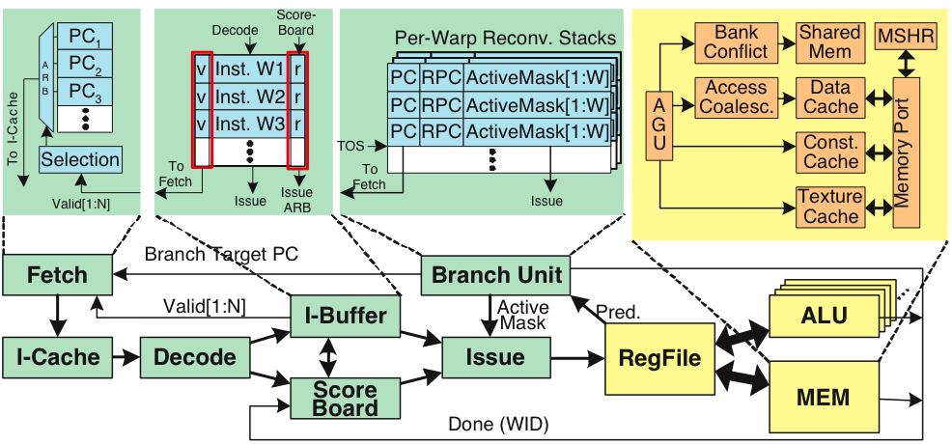
Register File
32 warps, 32 threads per warp, 16 x 32-bit registers per thread = 64KB register file.
Need “4 ports” (e.g., FMA) greatly increase area.
Alternative: banked single ported register file. How to avoid bank conflicts?

Slide 31
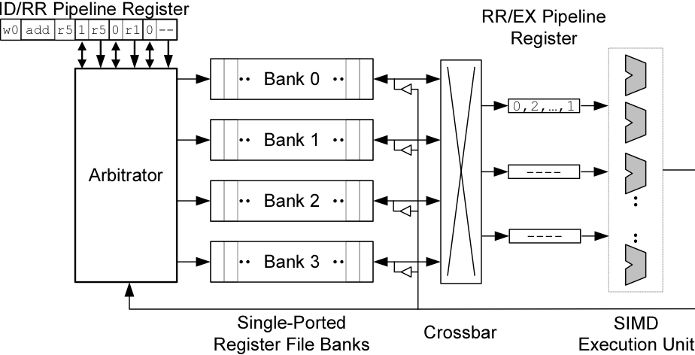
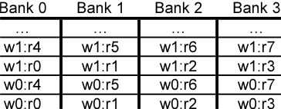
Banked Register File
Strawman microarchitecture:
Register layout:

Slide 32
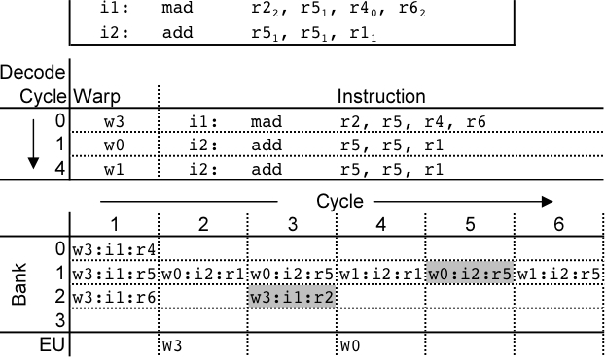
Register Bank Conflicts
warp 0, instruction 2 has two source operands in bank 1: takes two cycles to read.
Also, warp 1 instruction 2 is same and is also stalled.
Can use warp ID as part of register layout to help.

Slide 33
Operand Collector
Bank 0
Bank 1
Bank 2
Bank 3
R0
R1
R2
R3
R4
R5
R6
R7
R8
R9
R10
R11
…
…
…
…
add.s32 R3, R1, R2;
No Conflict
mul.s32 R3, R0, R4;
Conflict at bank 0
Term “Operand Collector” appears in figure in NVIDIA Fermi Whitepaper
Operand Collector Architecture (US Patent: 7834881)
Interleave operand fetch from different threads to achieve full utilization

Slide 34
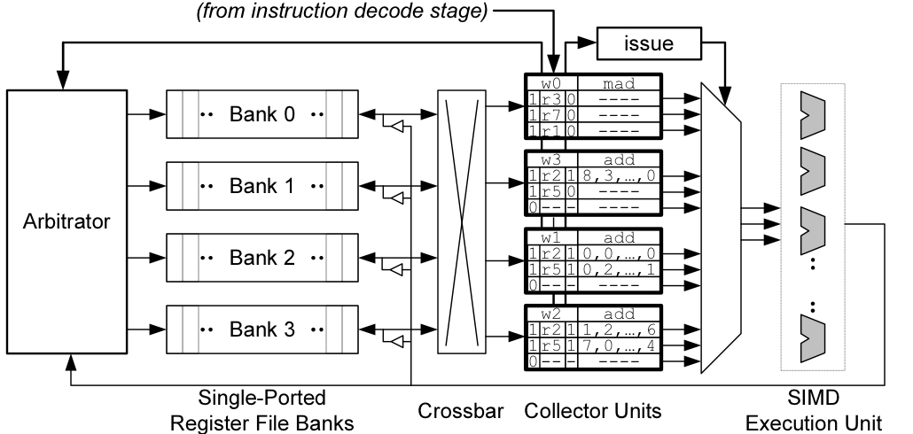
Operand Collector (1)
Issue instruction to collector unit.
Collector unit similar to reservation station in tomasulo’s algorithm.
Stores source register identifiers.
Arbiter selects operand accesses that do not conflict on a given cycle.
Arbiter needs to also consider writeback (or need read+write port)

Slide 35
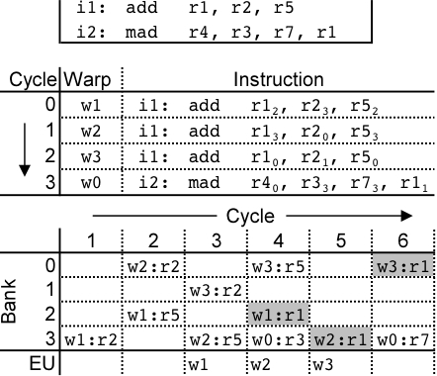
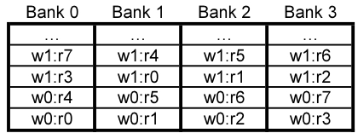
Operand Collector (2)
Combining swizzling and access scheduling can give up to ~ 2x improvement in throughput

Slide 36
AMD Southern Islands
SIMT processing often includes redundant computation across threads.
thread 0…31:
for( i=0; i < runtime_constant_N; i++ {
/* do something with “i” */
}

Slide 37
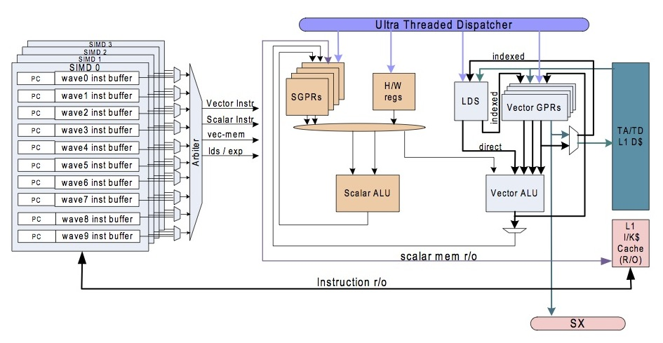
AMD Southern Islands SIMT-Core
ISA visible scalar unit executes computation identical across SIMT threads in a wavefront

Slide 38
Example
float fn0(float a,float b)
{
if(a>b)
return (a * a – b);
else
return (b * b – a);
}
// Registers r0 contains “a”, r1 contains “b”
// Value is returned in r2
v_cmp_gt_f32 r0, r1 // a>b
s_mov_b64 s0, exec // Save current exec mask
s_and_b64 exec, vcc, exec // Do “if”
s_cbranch_vccz label0 // Branch if all lanes fail
v_mul_f32 r2, r0, r0 // result = a * a
v_sub_f32 r2, r2, r1 // result = result - b
label0:
s_not_b64 exec, exec // Do “else”
s_and_b64 exec, s0, exec // Do “else”
s_cbranch_execz label1 // Branch if all lanes fail
v_mul_f32 r2, r1, r1 // result = b * b
v_sub_f32 r2, r2, r0 // result = result - a
label1:
s_mov_b64 exec, s0 // Restore exec mask
[Southern Islands Series Instruction Set Architecture, Aug. 2012]

Slide 39
Southern Islands SIMT Stack?
+
Instructions: S_CBRANCH_*_FORK; S_CBRANCH_JOIN
Use for arbitrary (e.g., irreducible) control flow
3-bit control stack pointer
Six 128-bit stack entries; stored in scalar general purpose registers holding {exec[63:0], PC[47:2]}
S_CBRANCH_*_FORK executes path with fewer active threads first

Slide 40
Part 3: Research Directions

Slide 41
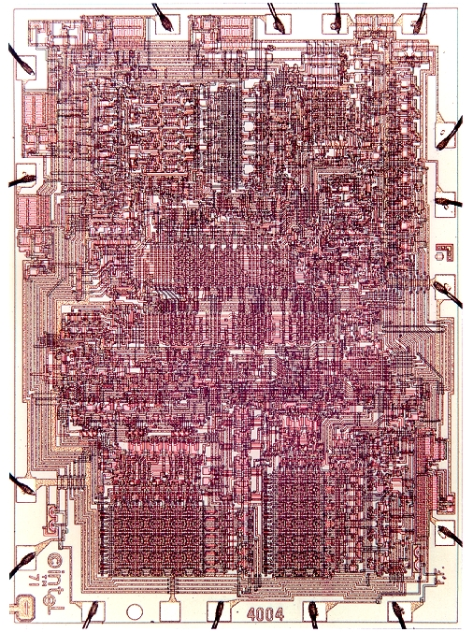
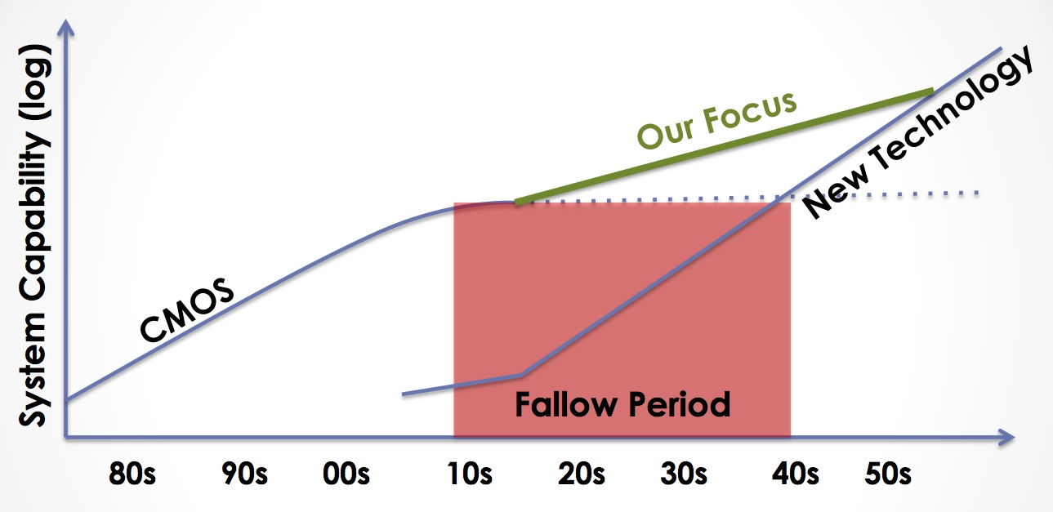
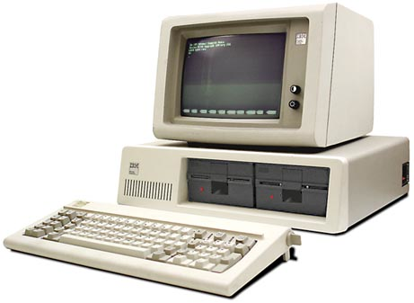
Decreasing cost per unit computation
1971: Intel 4004
2007: iPhone
Advancing Computer Systems without Technology Progress
DARPA/ISAT Workshop, March 26-27, 2012
Mark Hill & Christos Kozyrakis
2012: Datacenter
1981: IBM 5150
Notes:
Increasing transistor density has led to decreasing cost per unit computation… or what is equivalent increased capability per unit cost.
This leads to a rather famous exponential growth curve.
A quick review of the impact of this curve is in order:
- First microprocessor had 2300 transistors basically designed for a souped up calculator
- Today we carry around smartphones that have half a billion transistors in them. A large part of what makes them useful is the computing capability that resulted from technology scaling.
- Of course, not all computation takes place somewhere you can see it. A large amount of computation happens in datacenters that are hidden away out of sight behind the internet.
However, the traditional CMOS scaling that gave us all this is ending. ITRS projects we’ll end at the 7 nm process node. Others may put it at 5 nm. But either way this is happening really soon and likely within the next 10 years.
Of course, there are other technologies being proposed. However, none of them are ready for prime time.
Open question: can we continue increasing function per unit cost without CMOS scaling?

Slide 42
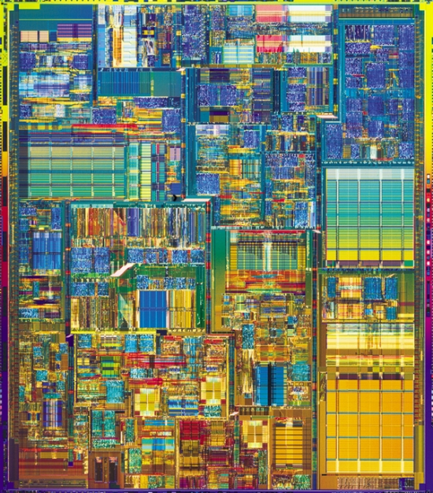
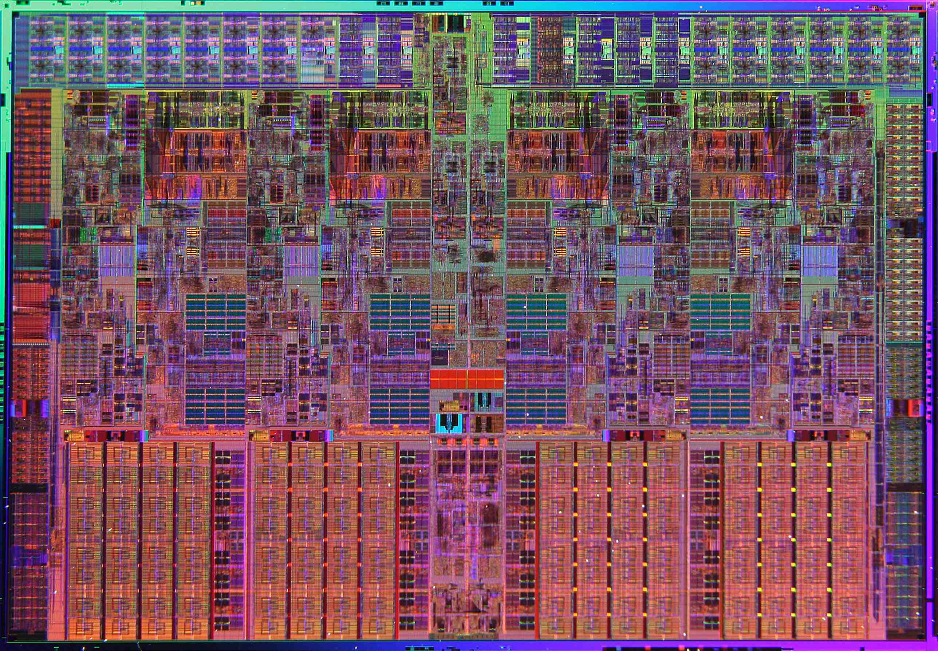
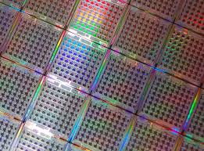
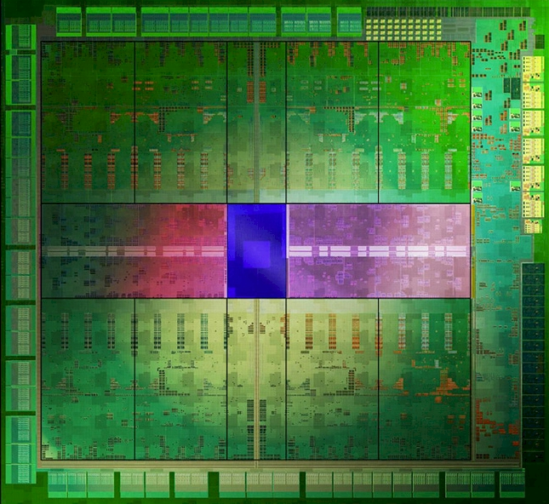
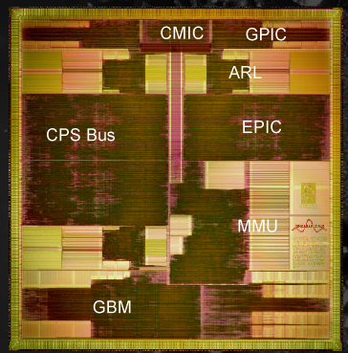
Single Core OoO Superscalar CPU
Better
(how to get here?)
Brawny (OoO) Multicore
Ease of
Programming
Wimpy (In-order) Multicore
16K thread, SIMT Accelerator
ASIC
Hardware Efficiency
Notes:
Approach 1: Start with easy to program hardware and improve HW efficiency
Approach 2: Start with efficient HW and make it easier to program

Slide 43
Start by using right tool for each job…
Ease of
Programming
Hardware Efficiency
Notes:
Approach 1: Start with easy to program hardware and improve HW efficiency
Approach 2: Start with efficient HW and make it easier to program

Slide 44
Amdahl’s Law Limits this Approach
Hard to accelerate
Easy to accelerate

Slide 45
Question: Can dividing line be moved?
easy to accelerate (Acc. Arch1)
easy to accelerate (Acc. Arch2)

Slide 46
Forward-Looking GPU Software
Still Massively Parallel
Less Structured
Memory access and control flow patterns are less predictable
Less efficient on today’s GPU
Molecular Dynamics
Raytracing
Execute efficiently on a GPU today
Object Classification
Graphics Shaders
…
…
Matrix Multiply

Slide 47
Two Routes to “Better”
Better
Ease of
Programming
Energy Efficiency
Notes:
Approach 1: Start with easy to program hardware and improve HW efficiency
Approach 2: Start with efficient HW and make it easier to program

Slide 48
Research Direction 1: Mitigating SIMT Control Divergence

Slide 49
Research Direction 2: Mitigating High GPGPU Memory Bandwidth Demands

Slide 50
Reducing Off-Chip Access / Divergence
Re-writing software to use “shared memory” and avoid uncoalesced global accesses is bane of GPU programmer existence.
Recent GPUs introduce caches, but large number of warps/wavefronts lead to thrashing.

Slide 51
NVIDIA: Register file cache (ISCA 2011, MICRO)
Register file burns significant energy
Many values read once soon after written
Small register file cache captures locality and saves energy but does not help performance
Recent follow on work from academia
Prefetching (Kim, MICRO 2010)
Interconnect (Bakhoda, MICRO 2010)
Lee & Kim (HPCA 2012) CPU/GPU cache sharing

Slide 52
Thread Scheduling Analogy [MICRO 2012]
Human Multitasking
Humans have limited attention capacity
GPUs have limited cache capacity
GPU Core
Processor
Cache

Slide 53
Use Memory System Feedback [MICRO 2012]
Cache Misses
Performance
GPU Core
Thread Scheduler
Processor
Cache
Feedback

Slide 54
Research Direction 3: Coherent Memory for Accelerators

Slide 55
Why GPU Coding Difficult?
Manual data movement CPU ⬄ GPU
Lack of generic I/O , system support on GPU
Need for performance tuning to reduce
off-chip accesses
memory divergence
control divergence
For complex algorithms, synchronization
Non-deterministic behavior for buggy code
Lack of good performance analysis tools

Slide 56
Manual CPU ⬄ GPU Data Movement
Problem #1: Programmer needs to identify data needed in a kernel and insert calls to move it to GPU
Problem #2: Pointer on CPU does not work on GPU since different address spaces
Problem #3: Bandwidth connecting CPU and GPU is order of magnitude smaller than GPU off-chip
Problem #4: Latency to transfer data from CPU to GPU is order of magnitude higher than GPU off-chip
Problem #5: Size of GPU DRAM memory much smaller than size of CPU main memory

Slide 57
Identifying data to move CPU ⬄ GPU
CUDA/OpenCL: Job of programmer ☹
C++AMP passes job to compiler.
OpenACC uses pragmas to indicate loops that should be offloaded to GPU.

Slide 58
Memory Model
Rapid change (making programming easier)
Late 1990’s: fixed function graphics only
2003: programmable graphics shaders
2006: + global/local/shared (GeForce 8)
2009: + caching of global/local
2011: + unified virtual addressing
2014: + unified memory / coherence

Slide 59
Caching
Scratchpad uses explicit data movement. Extra work. Beneficial when reuse pattern statically predictable.
NVIDIA Fermi / AMD Southern Island add caches for accesses to global memory space.

Slide 60
CPU memory vs. GPU global memory
Prior to CUDA: input data is texture map.
CUDA 1.0 introduces cudaMemcpy
Allows copy of data between CPU memory space to global memory on GPU
Still has problems:
#1: Programmer still has to think about it!
#2: Communicate only at kernel grid boundaries
#3: Different virtual address space
pointer on CPU not a pointer on GPU => cannot easily share complex data structures between CPU and GPU

Slide 61
Fusion / Integrated GPUs
Why integrate?
One chip versus two (cf. Moore’s Law, VLSI)
Latency and bandwidth of communication: shared physical address space, even if off-chip, eliminates copy: AMD Fusion. 1st iteration 2011. Same DRAM
Shared virtual address space? (AMD Kavari 2014)
Reduce latency to spawn kernel means kernel needs to do less to justify cost of launching

Slide 62
CPU Pointer not a GPU Pointer
NVIDIA Unified Virtual Memory partially solves the problem but in a bad way:
GPU kernel reads from CPU memory space
NVIDIA Uniform Memory (CUDA 6) improves by enabling automatic migration of data
Limited academic work. Gelado et al. ASPLOS 2010.

Slide 63
CPU ⬄ GPU Bandwidth
Shared DRAM as found in AMD Fusion (recent Core i7) enables the elimination of copies from CPU to GPU. Painful coding as of 2013.
One question how much benefit versus good coding. Our limit study (WDDD 2008) found only ~50% gain. Lustig & Martonosi HPCA 2013.
Algorithm design—MummerGPU++

Slide 64
CPU ⬄ GPU Latency
NVIDIA’s solution: CUDA Streams. Overlap GPU kernel computation with memory transfer. Stream = ordered sequence of data movement commands and kernels. Streams scheduled independently. Very painful programming.
Academic work: Limit Study (WDDD 2008), Lustig & Martonosi HPCA 2013, Compiler data movement (August, PLDI 2011).

Slide 65
GPU Memory Size
CUDA Streams
Academic work: Treat GPU memory as cache on CPU memory (Kim et al., ScaleGPU, IEEE CAL early access).

Slide 66
Solution to all these sub-issues?
Heterogeneous System Architecture: Integrated CPU and GPU with coherence memory address space.
Need to figure out how to provide coherence between CPU and GPU.
Really two problems: Coherence within GPU and then between CPU and GPU.

Slide 67
Research Direction 4: Easier Programming with Synchronization

Slide 68
Synchronization
Locks are not encouraged in current GPGPU programming manuals.
Interaction with SIMT stack can easily cause deadlocks:
while( atomicCAS(&lock[a[tid]],0,1) != 0 )
; // deadlock here if a[i] = a[j] for any i,j = tid in warp
// critical section goes here
atomicExch (&lock[a[tid]], 0) ;

Slide 69
Correct way to write critical section for GPGPU:
done = false;
while( !done ) {
if( atomicCAS (&lock[a[tid]], 0 , 1 )==0 ) {
// critical section goes here
atomicExch(&lock[a[tid]], 0 ) ;
}
}
Most current GPGPU programs use barriers within thread blocks and/or lock-free data structures.
This leads to the following picture…

Slide 70
Lifetime of GPU Application Development
Functionality
Performance
E.g. N-Body with 5M bodies CUDA SDK: O(n²) – 1640 s (barrier) Barnes Hut: O(nLogn) – 5.2 s (locks)
Time
Fine-Grained Locking/Lock-Free
Transactional Memory
?
Time
Time
Wilson Fung, Inderpeet Singh, Andrew Brownsword, Tor Aamodt
Notes:
Usually, developers can get the application running on GPU after a little bit of initial effort, and spend the rest of their time tuning the application for performance.
For application that require (or benefit from) fine-grained data synchronization, the developer may spend significant effort just to get the code working. As in the usual case, the first working code performs poorly, so effort to tune the application is still required. If the developers spend the effort to tune the code, the reward can be great. For example, O(nLogn) implementation of N-Body is orders of magnitude faster than the naïve implementation, but it is harder to get right because of locks.
Hypothesis 1: For applications that require fine-grained communication between tasks, developers will give up long before the code is working on a GPU, and even if they manage to get the application to run correctly, the performance will initially be bad and they may then decide they have wasted too much time for too little progress.
Hypothesis 2: With TM, the developer will get working code sooner, leaving time to tune the code for performance.
Even if there is a performance overhead for using TM it is a gain for the developer (better performing code with same effort).

Slide 71
Transactional Memory
Programmer specifies atomic code blocks called transactions [Herlihy’93]
Lock Version:
Lock(X[a]);
Lock(X[b]);
Lock(X[c]);
X[c] = X[a]+X[b];
Unlock(X[c]);
Unlock(X[b]);
Unlock(X[a]);
TM Version:
atomic {
X[c] = X[a]+X[b];
}
Potential Deadlock!

Slide 72
Transactional Memory
Programmers’ View:
TX1
Time
TX2
Time
OR
TX2
TX1
Non-conflicting transactions may run in parallel
Conflicting transactions automatically serialized
Memory
Memory
A
TX1
A
TX1
B
TX2
B
TX2
C
C
Commit
D
Abort
Commit
D
Commit
TX2
Commit
Notes:
In the programmers’ view, transactions are executed atomically in some order.
The underlying runtime system can optimistically run non-conflicting transactions in parallel.
Conflicting transactions may be resolved by aborting one of the transaction and restarting it later.

Slide 73
Are TM and GPUs Incompatible?
GPU uarch very different from multicore CPU…
KILO TM [MICRO’11, IEEE Micro Top Picks]
Hardware TM for GPUs
Half performance of fine grained locking
Chip area overhead of 0.5%
Hardware TM for GPU Architectures
73
Notes:
For those who know something about both TM and GPU, the two may seem to be incompatible concepts.
Yes, GPUs are different from multi core CPUs.
These differences lead to a set of challenges for supporting TM on GPU.
For each of these challenges, I will show you how KILO TM, our hardware TM for GPUs, addresses the challenge.

Slide 74
Research Direction 5: GPU Power Efficiency

Slide 75
GPU power
More efficient than CPU but
Consumes a lot of power
Much less efficient than ASIC or FPGAs
What can be done to reduce power consumption?
Look at the most power hungry components
What can be duty cycled/power gated?
GPUWattch to evaluate ideas

Slide 76
Other Research Directions….
Non-deterministic behavior for buggy code
GPUDet ASPLOS 2013
Lack of good performance analysis tools
NVIDIA Profiler/Parallel NSight
AerialVision [ISPASS 2010]
GPU analytical perf/power models (Hyesoon Kim)

Slide 77
Lack of I/O and System Support…
Support for printf, malloc from kernel in CUDA
File system I/O?
GPUfs (ASPLOS 2013):
POSIX-like file system API
One file per warp to avoid control divergence
Weak file system consistency model (close->open)
Performance API: O_GWRONCE, O_GWRONCE
Eliminate seek pointer
GPUnet (OSDI 2014): Posix like API for sockets programming on GPGPU.

Slide 78
Conclusions
GPU Computing is growing in importance due to energy efficiency concerns
GPU architecture has evolved quickly and likely to continue to do so
We discussed some of the important microarchitecture bottlenecks and recent research.
Also discussed some directions for improving programming model

