Slide 1
CS/EE 217 GPU Architecture and Parallel Programming Lecture 21: Joint CUDA-MPI Programming

Slide 2
Objective
To become proficient in writing simple joint MPI-CUDA heterogeneous applications
Understand the key sections of the application
Simplified code and efficient data movement using GMAC
One-way communication
To become familiar with a more sophisticated MPI application that requires two-way data-exchange

Slide 3
CUDA-based cluster
Each node contains N GPUs
GPU 0
…
GPU N
GPU 0
…
GPU N
PCIe
PCIe
PCIe
PCIe
CPU 0
…
CPU M
CPU 0
…
CPU M
Host Memory
Host Memory

Slide 4
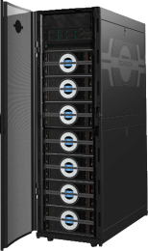
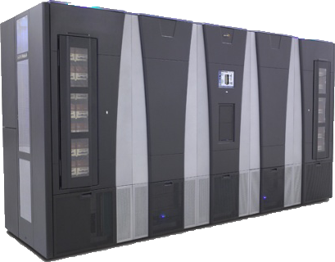
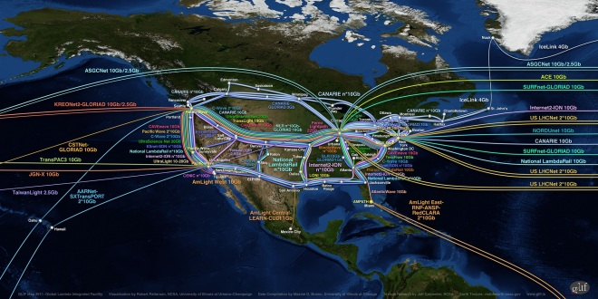
Blue Waters Computing System
IB Switch
>1 TB/sec
10/40/100 Gb
Ethernet Switch
100 GB/sec
120+ Gb/sec
WAN
Spectra Logic: 300 PBs
Sonexion: 26 PBs
Notes:
Note just compute – main memory (1.6PB); Disk (26PB); near line (300PB)

Slide 5
Cray XE6 Nodes
Dual-socket Node
Two AMD Interlagos chips
16 core modules, 64 threads
313 GFs peak performance
64 GBs memory
102 GB/sec memory bandwidth
Gemini Interconnect
Router chip & network interface
Injection Bandwidth (peak)
9.6 GB/sec per direction
HT3
HT3
Blue Waters contains 22,640 Cray XE6 compute nodes.

Slide 6
Cray XK7 Nodes
Dual-socket Node
One AMD Interlagos chip
8 core modules, 32 threads
156.5 GFs peak performance
32 GBs memory
51 GB/s bandwidth
One NVIDIA Kepler chip
1.3 TFs peak performance
6 GBs GDDR5 memory
250 GB/sec bandwidth
Gemini Interconnect
Same as XE6 nodes
PCIe Gen2
HT3
HT3
Blue Waters contains 3,072 Cray XK7 compute nodes.

Slide 7
Gemini Interconnect Network
Blue Waters
3D Torus Size
23 x 24 x 24
InfiniBand
Login
Servers
Network(s)
GigE
SMW
Y
Fibre Channel
X
Boot Raid
Z
Infiniband
Interconnect
Network
Lustre
Compute Nodes
Service Nodes
Cray XE6 Compute
Operating System
Login/Network
Cray XK7 Accelerator
Boot
Login Gateways
System Database
Network
Lustre File System
LNET Routers
Notes:
Note mixed elements in Torus; note complexity in assigning blocks of processes to Torus.

Slide 8
Science Area | Number of Teams | Codes | Struct Grids | Unstruct Grids | Dense Matrix | Sparse Matrix | N-Body | Monte Carlo | FFT | PIC | Significant I/O
Climate and Weather | 3 | CESM, GCRM, CM1/WRF, HOMME | X | X |  | X |  | X |  |  | X
Plasmas/Magnetosphere | 2 | H3D(M),VPIC, OSIRIS, Magtail/UPIC | X |  |  |  | X |  | X |  | X
Stellar Atmospheres and Supernovae | 5 | PPM, MAESTRO, CASTRO, SEDONA, ChaNGa, MS-FLUKSS | X |  |  | X | X | X |  | X | X
Cosmology | 2 | Enzo, pGADGET | X |  |  | X | X
Combustion/Turbulence | 2 | PSDNS, DISTUF | X |  |  |  |  |  | X
General Relativity | 2 | Cactus, Harm3D, LazEV | X |  |  | X
Molecular Dynamics | 4 | AMBER, Gromacs, NAMD, LAMMPS |  |  |  | X | X |  | X
Quantum Chemistry | 2 | SIAL, GAMESS, NWChem |  |  | X | X | X | X |  |  | X
Material Science | 3 | NEMOS, OMEN, GW, QMCPACK |  |  | X | X | X | X
Earthquakes/Seismology | 2 | AWP-ODC, HERCULES, PLSQR, SPECFEM3D | X | X |  |  | X |  |  |  | X
Quantum Chromo Dynamics | 1 | Chroma, MILC, USQCD | X |  | X | X
Social Networks | 1 | EPISIMDEMICS
Evolution | 1 | Eve
Engineering/System of Systems | 1 | GRIPS,Revisit |  |  |  |  |  | X
Computer Science | 1 |  |  | X | X | X |  |  | X |  | X

Slide 9
MPI Model
Many processes distributed in a cluster
Each process computes part of the output
Processes communicate with each other
Processes can synchronize
Node
Node
Node
Node

Slide 10
MPI Initialization, Info and Sync
int MPI_Init(int *argc, char ***argv)
Initialize MPI
MPI_COMM_WORLD
MPI group with all allocated nodes
int MPI_Comm_rank (MPI_Comm comm, int *rank)
Rank of the calling process in group of comm
int MPI_Comm_size (MPI_Comm comm, int *size)
Number of processes in the group of comm

Slide 11
Vector Addition: Main Process
int main(int argc, char *argv[]) {
int vector_size = 1024 * 1024 * 1024;
int pid=-1, np=-1;
MPI_Init(&argc, &argv);
MPI_Comm_rank(MPI_COMM_WORLD, &pid);
MPI_Comm_size(MPI_COMM_WORLD, &np);
if(np < 3) {
if(0 == pid) printf(“Need 3 or more processes.\n");
MPI_Abort( MPI_COMM_WORLD, 1 ); return 1;
}
if(pid < np - 1)
compute_node(vector_size / (np - 1));
else
data_server(vector_size);
MPI_Finalize();
return 0;
}

Slide 12
MPI Sending Data
int MPI_Send(void *buf, int count, MPI_Datatype datatype, int dest, int tag, MPI_Comm comm)
buf: Initial address of send buffer (choice)
count: Number of elements in send buffer (nonnegative integer)
datatype: Datatype of each send buffer element (handle)
dest: Rank of destination (integer)
tag: Message tag (integer)
comm: Communicator (handle)

Slide 13
MPI Sending Data
int MPI_Send(void *buf, int count, MPI_Datatype datatype, int dest, int tag, MPI_Comm comm)
Buf: Initial address of send buffer (choice)
Count: Number of elements in send buffer (nonnegative integer)
Datatype: Datatype of each send buffer element (handle)
Dest: Rank of destination (integer)
Tag: Message tag (integer)
Comm: Communicator (handle)
Node
Node
Node
Node

Slide 14
MPI Receiving Data
int MPI_Recv(void *buf, int count, MPI_Datatype datatype, int source, int tag, MPI_Comm comm, MPI_Status *status)
Buf: Initial address of receive buffer (choice)
Count: Maximum number of elements in receive buffer (integer)
Datatype: Datatype of each receive buffer element (handle)
Source: Rank of source (integer)
Tag: Message tag (integer)
Comm: Communicator (handle)
Status: Status object (Status)

Slide 15
MPI Receiving Data
int MPI_Recv(void *buf, int count, MPI_Datatype datatype, int source, int tag, MPI_Comm comm, MPI_Status *status)
Buf: Initial address of receive buffer (choice)
Count: Maximum number of elements in receive buffer (integer)
Datatype: Datatype of each receive buffer element (handle)
Source: Rank of source (integer)
Tag: Message tag (integer)
Comm: Communicator (handle)
Status: Status object (Status)
Node
Node
Node
Node

Slide 16
Vector Addition: Server Process (I)
void data_server(unsigned int vector_size) {
int np, num_nodes = np – 1, first_node = 0, last_node = np - 2;
unsigned int num_bytes = vector_size * sizeof(float);
float *input_a = 0, *input_b = 0, *output = 0;
/* Set MPI Communication Size */
MPI_Comm_size(MPI_COMM_WORLD, &np);
/* Allocate input data */
input_a = (float *)malloc(num_bytes);
input_b = (float *)malloc(num_bytes);
output = (float *)malloc(num_bytes);
if(input_a == NULL || input_b == NULL || output == NULL) {
printf(“Server couldn't allocate memory\n");
MPI_Abort( MPI_COMM_WORLD, 1 );
}
/* Initialize input data */
random_data(input_a, vector_size , 1, 10);
random_data(input_b, vector_size , 1, 10);

Slide 17
Vector Addition: Server Process (II)
/* Send data to compute nodes */
float *ptr_a = input_a;
float *ptr_b = input_b;
for(int process = 1; process < last_node; process++) {
MPI_Send(ptr_a, vector_size / num_nodes, MPI_FLOAT,
process, DATA_DISTRIBUTE, MPI_COMM_WORLD);
ptr_a += vector_size / num_nodes;
MPI_Send(ptr_b, vector_size / num_nodes, MPI_FLOAT,
process, DATA_DISTRIBUTE, MPI_COMM_WORLD);
ptr_b += vector_size / num_nodes;
}
/* Wait for nodes to compute */
MPI_Barrier(MPI_COMM_WORLD);

Slide 18
Vector Addition: Server Process (III)
/* Wait for previous communications */ MPI_Barrier(MPI_COMM_WORLD);
/* Collect output data */
MPI_Status status;
for(int process = 0; process < num_nodes; process++) {
MPI_Recv(output + process * num_points / num_nodes,
num_points / num_comp_nodes, MPI_REAL, process,
DATA_COLLECT, MPI_COMM_WORLD, &status );
}
/* Store output data */
store_output(output, dimx, dimy, dimz);
/* Release resources */
free(input);
free(output);
}

Slide 19
Vector Addition: Compute Process (I)
void compute_node(unsigned int vector_size ) {
int np;
unsigned int num_bytes = vector_size * sizeof(float);
float *input_a, *input_b, *output;
MPI_Status status;
MPI_Comm_size(MPI_COMM_WORLD, &np);
int server_process = np - 1;
/* Alloc host memory */
input_a = (float *)malloc(num_bytes);
input_b = (float *)malloc(num_bytes);
output = (float *)malloc(num_bytes);
/* Get the input data from server process */
MPI_Recv(input_a, vector_size, MPI_FLOAT, server_process,
DATA_DISTRIBUTE, MPI_COMM_WORLD, &status);
MPI_Recv(input_b, vector_size, MPI_FLOAT, server_process,
DATA_DISTRIBUTE, MPI_COMM_WORLD, &status);

Slide 20
Vector Addition: Compute Process (II)
/* Compute the partial vector addition */
for(int i = 0; i < vector_size; ++i) {
output[i] = input_a[i] + input_b[i];
}
/* Send the output */
MPI_Send(output, vector_size, MPI_FLOAT,
server_process, DATA_COLLECT, MPI_COMM_WORLD);
/* Release memory */
free(input_a);
free(input_b);
free(output);
}

Slide 21
Detour: Global Memory for Accelerators

Slide 22
GMAC
User level library to support shared address space between CPU and accelerator
Hides the details of data transfer to and from the accelerator from the programmer
Designed to integrate accelerators with MPI

Slide 23
GMAC Memory Model
Unified CPU / GPU virtual address space
Asymmetric address space visibility
Shared Data
Memory
CPU
GPU
CPU Data

Slide 24
ADSM Consistency Model
Implicit acquire / release primitives at accelerator call / return boundaries
CPU
GPU
CPU
GPU

Slide 25
GMAC Memory API
Memory allocation
gmacError_t gmacMalloc(void **ptr, size_t size)
Allocated memory address (returned by reference)
Gets the size of the data to be allocated
Error code, gmacSuccess if no error
Example usage
#include <gmac/cuda.h>
int main(int argc, char *argv[]) {
float *foo = NULL;
gmacError_t error;
if((error = gmacMalloc((void **)&foo, FOO_SIZE)) != gmacSuccess)
FATAL(“Error allocating memory %s”, gmacErrorString(error));
. . .
}

Slide 26
GMAC Memory API
Memory release
gmacError_t gmacFree(void *ptr)
Memory address to be release
Error code, gmacSuccess if no error
Example usage
#include <gmac/cuda.h>
int main(int argc, char *argv[]) {
float *foo = NULL;
gmacError_t error;
if((error = gmacMalloc((void **)&foo, FOO_SIZE)) != gmacSuccess)
FATAL(“Error allocating memory %s”, gmacErrorString(error));
. . .
gmacFree(foo);
}

Slide 27
ADSM Eager Update
Asynchronous data transfers while the CPU computes
Optimized data transfers:
Memory block granularity
Avoid copies on Integrated GPU Systems
System
Memory
Accelerator
Memory
CPU
GPU

Slide 28
ADSM Coherence Protocol
Only meaningful for the CPU
Three state protocol:
Modified: data in the in the CPU
Shared: data is in both, CPU and GPU
Invalid: data is in the GPU
I
Read
Write
M
Invalidate
S
Flush

Slide 29
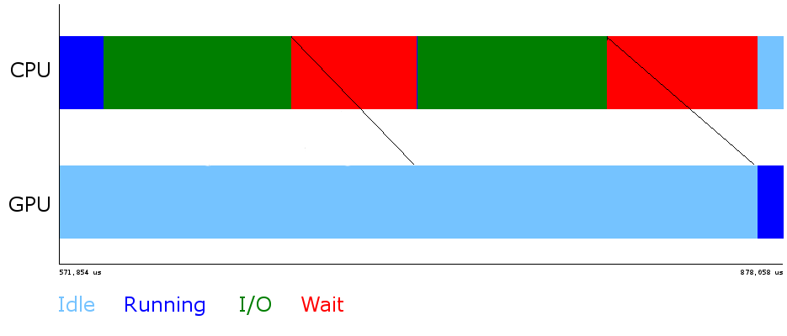
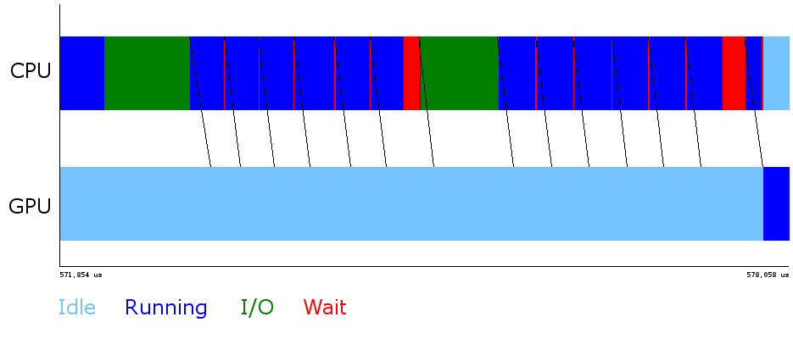
GMAC Optimizations
Global Memory for Accelerators : user-level ADSM run-time
Optimized library calls: memset, memcpy, fread, fwrite, MPI_send, MPI_receive
Double buffering of data transfers
Transfer to GPU while reading from disk

Slide 30
GMAC in Code (I)
int main(int argc, char *argv[])
{
FILE *fp;
struct stat file_stat;
gmacError_t gmac_ret;
void *buffer;
timestamp_t start_time, end_time;
float bw;
if(argc < LAST_PARAM) FATAL("Bad argument count");
if((fp = fopen(argv[FILE_NAME], "r")) < 0)
FATAL("Unable to open %s", argv[FILE_NAME]);
if(fstat(fileno(fp), &file_stat) < 0)
FATAL("Unable to read meta data for %s", argv[FILE_NAME]);

Slide 31
GMAC in Code (I)
gmac_ret = gmacMalloc(&buffer, file_stat.st_size);
if(gmac_ret != gmacSuccess) FATAL("Unable to allocate memory");
start_time = get_timestamp();
if(fread(buffer, 1, file_stat.st_size, fp) < file_stat.st_size)
FATAL("Unable to read data from %s", argv[FILE_NAME]);
gmac_ret = gmacThreadSynchronize();
if(gmac_ret != gmacSuccess) FATAL("Unable to wait for device");
end_time = get_timestamp();
bw = 1.0f * file_stat.st_size / (end_time - start_time);
fprintf(stdout, "%d bytes in %f msec : %f MBps\n", file_stat.st_size,
1e-3f * (end_time - start_time), bw);
gmac_ret = gmacFree(buffer);
if(gmac_ret != gmacSuccess) FATAL("Unable to free device memory");
fclose(fp);
return 0;
}

Slide 32
Performance of GMAC

Slide 33
Adding CUDA to MPI

Slide 34
Vector Addition: CUDA Process (I)
void compute_node(unsigned int vector_size ) {
int np;
unsigned int num_bytes = vector_size * sizeof(float);
float *input_a, *input_b, *output;
MPI_Status status;
MPI_Comm_size(MPI_COMM_WORLD, &np);
int server_process = np - 1;
/* Allocate memory */
gmacMalloc((void **)&input_a, num_bytes);
gmacMalloc((void **)&input_b, num_bytes);
gmacMalloc((void **)&output, num_bytes);
/* Get the input data from server process */
MPI_Recv(input_a, vector_size, MPI_FLOAT, server_process,
DATA_DISTRIBUTE, MPI_COMM_WORLD, &status);
MPI_Recv(input_b, vector_size, MPI_FLOAT, server_process,
DATA_DISTRIBUTE, MPI_COMM_WORLD, &status);

Slide 35
Vector Addition: CUDA Process (II)
/* Compute the partial vector addition */
dim3 Db(BLOCK_SIZE);
dim3 Dg((vector_size + BLOCK_SIZE – 1) / BLOCK_SIZE);
vector_add_kernel<<<Dg, Db>>>(gmacPtr(output), gmacPtr(input_a),
gmacPtr(input_b), vector_size);
gmacThreadSynchronize();
/* Send the output */
MPI_Send(output, vector_size, MPI_FLOAT,
server_process, DATA_COLLECT, MPI_COMM_WORLD);
/* Release device memory */
gmacFree(d_input_a);
gmacFree(d_input_b);
gmacFree(d_output);
}

Slide 36
A Typical Wave Propagation Application
Do T = 0, Tmax
Insert Source
(e.g. acoustic wave)
Stencil Computation to compute Laplacian
Time Integration
Absorbing Boundary Conditions
T == Tmax

Slide 37
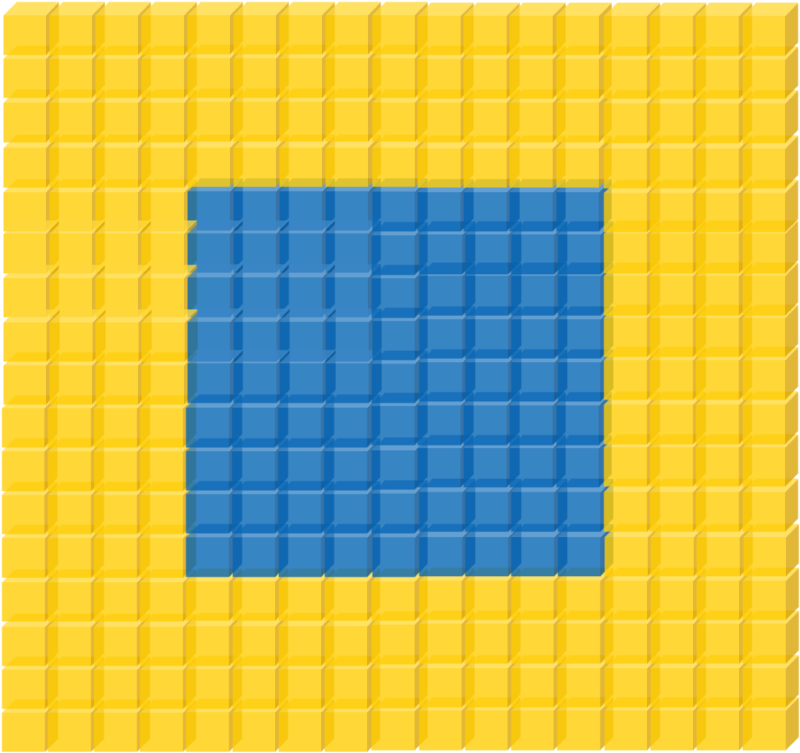
Review of Stencil Computations
Example: wave propagation modeling
$$∇^{2}U−\frac{1}{v^{2}}\frac{∂U}{∂t}=0$$
Approximate Laplacian using finite differences
Boundary Conditions
Laplacian and Time Integration

Slide 38
Wave Propagation: Kernel Code
/* Coefficients used to calculate the laplacian */
__constant__ float coeff[5];
__global__ void wave_propagation(float *next, float *in,
float *prev, float *velocity, dim3 dim)
{
unsigned x = threadIdx.x + blockIdx.x * blockDim.x;
unsigned y = threadIdx.y + blockIdx.y * blockDim.y;
unsigned z = threadIdx.z + blockIdx.z * blockDim.z;
/* Point index in the input and output matrixes */
unsigned n = x + y * dim.z + z * dim.x * dim.y;
/* Only compute for points within the matrixes */
if(x < dim.x && y < dim.y && z < dim.z) {
/* Calculate the contribution of each point to the laplacian */
float laplacian = coeff[0] + in[n];

Slide 39
Wave Propagation: Kernel Code
for(int i = 1; i < 5; ++i) {
laplacian += coeff[i] *
(in[n – i] + /* Left */
in[n + i] + /* Right */
in[n – i * dim.x] + /* Top */
in[n + I * dim.x] + /* Bottom */
in[n – i * dim.x * dim.y] + /* Behind */
in[n + i * dim.x * dim.y]); /* Front */
}
/* Time integration */
next[n] = velocity[n] * laplacian + 2 * in[n] – prev[n];
}
}

Slide 40
Stencil Domain Decomposition
Volumes are split into tiles (along the Z-axis)
3D-Stencil introduces data dependencies
D2
D4
x
y
z
D1
D3

Slide 41
Wave Propagation: Main Process
int main(int argc, char *argv[]) {
int pad = 0, dimx = 480+pad, dimy = 480, dimz = 400, nreps = 100;
int pid=-1, np=-1;
MPI_Init(&argc, &argv);
MPI_Comm_rank(MPI_COMM_WORLD, &pid);
MPI_Comm_size(MPI_COMM_WORLD, &np);
if(np < 3) {
if(0 == pid) printf(“Nedded 3 or more processes.\n");
MPI_Abort( MPI_COMM_WORLD, 1 ); return 1;
}
if(pid < np - 1)
compute_node(dimx, dimy, dimz / (np - 1), nreps);
else
data_server( dimx,dimy,dimz, nreps );
MPI_Finalize();
return 0;
}

Slide 42
Stencil Code: Server Process (I)
void data_server(int dimx, int dimy, int dimz, int nreps) {
int np, num_comp_nodes = np – 1, first_node = 0, last_node = np - 2;
unsigned int num_points = dimx * dimy * dimz;
unsigned int num_bytes = num_points * sizeof(float);
float *input=0, *output = NULL, *velocity = NULL;
/* Set MPI Communication Size */
MPI_Comm_size(MPI_COMM_WORLD, &np);
/* Allocate input data */
input = (float *)malloc(num_bytes);
output = (float *)malloc(num_bytes);
velocity = (float *)malloc(num_bytes);
if(input == NULL || output == NULL || velocity == NULL) {
printf(“Server couldn't allocate memory\n");
MPI_Abort( MPI_COMM_WORLD, 1 );
}
/* Initialize input data and velocity */
random_data(input, dimx, dimy ,dimz , 1, 10);
random_data(velocity, dimx, dimy ,dimz , 1, 10);

Slide 43
Stencil Code: Server Process (II)
/* Calculate number of shared points */
int edge_num_points = dimx * dimy * (dimz / num_comp_nodes + 4);
int int_num_points = dimx * dimy * (dimz / num_comp_nodes + 8);
float *input_send_address = input;
/* Send input data to the first compute node */
MPI_Send(send_address, edge_num_points, MPI_REAL, first_node,
DATA_DISTRIBUTE, MPI_COMM_WORLD );
send_address += dimx * dimy * (dimz / num_comp_nodes - 4);
/* Send input data to "internal" compute nodes */
for(int process = 1; process < last_node; process++) {
MPI_Send(send_address, int_num_points, MPI_FLOAT, process,
DATA_DISTRIBUTE, MPI_COMM_WORLD);
send_address += dimx * dimy * (dimz / num_comp_nodes);
}
/* Send input data to the last compute node */
MPI_Send(send_address, edge_num_points, MPI_REAL, last_node,
DATA_DISTRIBUTE, MPI_COMM_WORLD);

Slide 44
Stencil Code: Server Process (II)
float *velocity_send_address = velocity;
/* Send velocity data to compute nodes */
for(int process = 0; process < last_node + 1; process++) {
MPI_Send(send_address, edge_num_points, MPI_FLOAT, process,
DATA_DISTRIBUTE, MPI_COMM_WORLD);
send_address += dimx * dimy * (dimz / num_comp_nodes);
}
/* Wait for nodes to compute */
MPI_Barrier(MPI_COMM_WORLD);
/* Collect output data */
MPI_Status status;
for(int process = 0; process < num_comp_nodes; process++)
MPI_Recv(output + process * num_points / num_comp_nodes,
num_points / num_comp_nodes, MPI_FLOAT, process,
DATA_COLLECT, MPI_COMM_WORLD, &status );
}

Slide 45
Stencil Code: Server Process (III)
/* Store output data */
store_output(output, dimx, dimy, dimz);
/* Release resources */
free(input);
free(velocity);
free(output);
}

Slide 46
Stencil Code: Compute Process (I)
void compute_node_stencil(int dimx, int dimy, int dimz, int nreps ) {
int np, pid;
MPI_Comm_rank(MPI_COMM_WORLD, &pid);
MPI_Comm_size(MPI_COMM_WORLD, &np);
unsigned int num_points = dimx * dimy * (dimz + 8);
unsigned int num_bytes = num_points * sizeof(float);
unsigned int num_ghost_points = 4 * dimx * dimy;
unsigned int num_ghost_bytes = num_ghost_points * sizeof(float);
int left_ghost_offset = 0;
int right_ghost_offset = dimx * dimy * (4 + dimz);
float *input = NULL, *output = NULL, *prev = NULL, *v = NULL;
/* Allocate device memory for input and output data */
gmacMalloc((void **)&input, num_bytes);
gmacMalloc((void **)&output, num_bytes);
gmacMalloc((void **)&prev, num_bytes);
gmacMalloc((void **)&v, num_bytes);

Slide 47
Stencil Code: Compute Process (II)
MPI_Status status;
int left_neighbor = (pid > 0) ? (pid - 1) : MPI_PROC_NULL;
int right_neighbor = (pid < np - 2) ? (pid + 1) : MPI_PROC_NULL;
int server_process = np - 1;
/* Get the input data from server process */
float *rcv_address = input + num_ghost_points * (0 == pid);
MPI_Recv(rcv_address, num_points, MPI_FLOAT, server_process,
DATA_DISTRIBUTE, MPI_COMM_WORLD, &status );
/* Get the velocity data from server process */
rcv_address = h_v + num_ghost_points * (0 == pid);
MPI_Recv(rcv_address, num_points, MPI_FLOAT, server_process,
DATA_DISTRIBUTE, MPI_COMM_WORLD, &status );

Slide 48
Questions?

