Slide 1
CS/EE 217 GPU Architecture and Parallel Programming Lecture 23: Introduction to OpenACC

Slide 2
Objective
To Understand the OpenACC programming model
basic concepts and pragmatypes
Simple examples to illustrate basic concepts and functionalities

Slide 3
OpenMP and OpenACC Pragmas
In C and C++, the #pragma directive is the method to provide, to the compiler, information that is not specified in the standard language.
A sequential compiler can just ignore the pragmas to produce sequential code
If you are careful

Slide 4
OpenACC extends OpenMP
OpenMP is a shared memory parallel programming API
It uses pragmas (or compiler directives) to specify parallel regions within a program
OpenACC extends openMP to allow some of the code to run on GPUs/acclerators
Also using pragmas

Slide 5
Example of OpenMP
#include <stdio.h>
int main(void) {
#pragma omp parallel
printf("Hello, world.\n");
return 0;
}
To compile: gcc -fopenmp hello.c -o hello
What will the output be?

Slide 6
More interesting example
int main(int argc, char **argv)
{
int a[100000];
#pragma omp parallel for
int i;
for (i = 0; i < 100000; i++)
a[i] = 2 * i;
return 0;
}

Slide 7
Summary of OpenACC directives

Slide 8
OpenACC
The OpenACC Application Programming Interface provides a set of
compiler directives (pragmas)
library routines and
environment variables
that can be used to write data parallel FORTRAN, C and C++ programs that run on accelerator devices including GPUs and CPUs

Slide 9
Simple Matrix-Matrix Multiplication in OpenACC
1 void computeAcc(float *P, const float *M, const float *N, int Mh, int Mw, int Nw)
2 {
3
4 #pragma acc parallel loop copyin(M[0:Mh*Mw]) copyin(N[0:Nw*Mw]) copyout(P[0:Mh*Nw])
5 for (int i=0; i<Mh; i++) {
6 #pragma acc loop
7 for (int j=0; j<Nw; j++) {
8 float sum = 0;
9 for (int k=0; k<Mw; k++) {
10 float a = M[i*Mw+k];
11 float b = N[k*Nw+j];
12 sum += a*b;
13 }
14 P[i*Nw+j] = sum;
15 }
16 }
17 }

Slide 10
Some Observations
The code is almost identical to the sequential version, except for the two lines with #pragma at line 4 and line 6.
OpenACC uses the compiler directive mechanism to extend the base language.
#pragma at line 4 tells the compiler to generate code for the ‘i’ loop at line 5 through 16 so that the loop iterations are executed in parallel on the accelerator.
The copyin clause and the copyout clause specify how the matrix data should be transferred between the host and the accelerator. The #pragma at line 6 instructs the compiler to map the inner ‘j’ loop to the second level of parallelism on the accelerator.

Slide 11
Motivation
OpenACC programmers can often start with writing a sequential version and then annotate their sequential program with OpenACC directives.
leave most of the details in generating a kernel and data transfers to the OpenACC compiler.
OpenACC code can be compiled by non-OpenACC compilers by ignoring the pragmas.

Slide 12
Frequently Encountered Issues
Some OpenACC pragmas are hints to the OpenACC compiler, which may or may not be able to act accordingly
The performance of an OpenACC depends heavily on the quality of the compiler.
Much less so in CUDA or OpenCL
Some OpenACC programs may behave differently or even incorrectly if pragmas are ignored

Slide 13
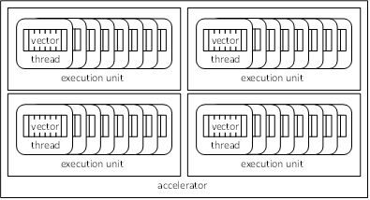
OpenACC Device Model
Currently OpenACC does not allow synchronization across threads.

Slide 14
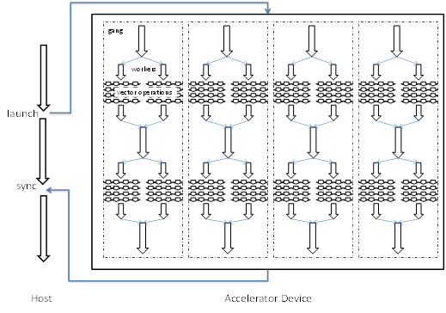
OpenACC Execution Model

Slide 15
Parallel vs. Loop Constructs
#pragma acc parallel loop copyin(M[0:Mh*Mw]) copyin(N[0:Nw*Mw]) copyout(P[0:Mh*Nw])
for (int i=0; i<Mh; i++) {
…
}
is equivalent to:
#pragma acc parallel copyin(M[0:Mh*Mw]) copyin(N[0:Nw*Mw]) copyout(P[0:Mh*Nw])
{
#pragma acc loop
for (int i=0; i<Mh; i++) {
…
}
}
(a parallel region that consists of just a loop)

Slide 16
Parallel Construct
A parallel construct is executed on an accelerator
One can specify the number of gangs and number of works in each gang
#pragma acc parallel copyout(a) num_gangs(1024) num_workers(32)
{
a = 23;
}
1024*32 workers will be created. a=23 will be executed redundantly by all 1024 gang leads

Slide 17
What does each “Gang Loop” do?
#pragma acc parallel num_gangs(1024)
{
for (int i=0; i<2048; i++) {
…
}
}
#pragma acc parallel num_gangs(1024)
{
#pragma acc loop gang
for (int i=0; i<2048; i++) {
…
}
}

Slide 18
Worker Loop
#pragma acc parallel num_gangs(1024) num_workers(32)
{
#pragma acc loop gang
for (int i=0; i<2048; i++) {
#pragma acc loop worker
for (int j=0; j<512; j++) {
foo(i,j);
}
}
}
1024*32=32K workers will be created, each executing 1M/32K = 32 instance of foo()

Slide 19
#pragma acc parallel num_gangs(32)
{
Statement 1; Statement 2;
#pragma acc loop gang
for (int i=0; i<n; i++) {
Statement 3; Statement 4;
}
Statement 5; Statement 6;
#pragma acc loop gang
for (int i=0; i<m; i++) {
Statement 7; Statement 8;
}
Statement 9;
if (condition)
Statement 10;
}
Statements 1 and 2 are redundantly executed by 32 gangs
The n for-loop iterations are distributed to 32 gangs

Slide 20
Kernel Regions
#pragma acc kernels
{
#pragma acc loop num_gangs(1024)
for (int i=0; i<2048; i++) {
a[i] = b[i];
}
#pragma acc loop num_gangs(512)
for (int j=0; j<2048; j++) {
c[j] = a[j]*2;
}
for (int k=0; k<2048; k++) {
d[k] = c[k];
}
}
Kernel constructs are descriptive of programmer intentions

Slide 21
Any MORE Questions? Read Chapter 15

